Slide 1
OL Series 754 Portable UV-VIS-NIR Spectroradiometer

Slide 2
• The OL 754 Portable UV-Visible-NIR Spectroradiometers are a series of compact, portable, double monochromator based spectroradiometers capable of making highly accurate spectroradiometric measurements in the laboratory or in the field. Three optics heads are available for covering the wavelength range of 200 to 1600 nm. The OL 754's innovative design combines compact UV-Visible (200 - 800 nm), Visible (350 - 1100 nm), or NIR (800 - 1600) optimized double monochromators with a separate controller that houses all data acquisition and control electronics. Fast and accurate spectroradiometric measurements can be made in the laboratory, or with the battery/dc power option, outside with total portability under demanding field conditions. The system can be configured to for various measurement applications: • Source Spectral Analysis • Diffuse Spectral Reflectance • Specular Spectral Reflectance • Spectral Transmittance
BACKGROUND

Slide 3
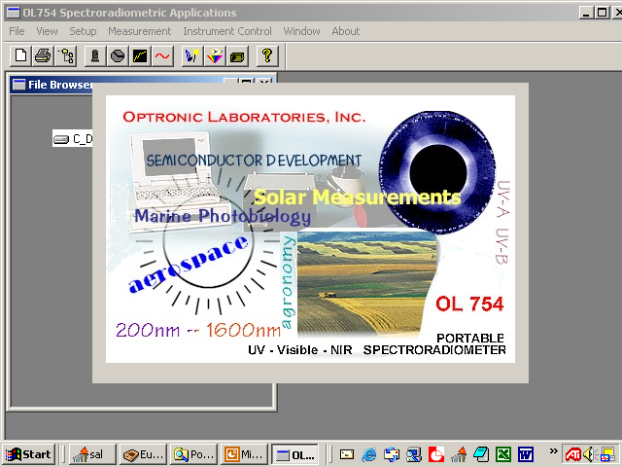
Compatible with Windows® 2000/XP
WINDOWS®
APPLICATION SOFTWARE

Slide 4
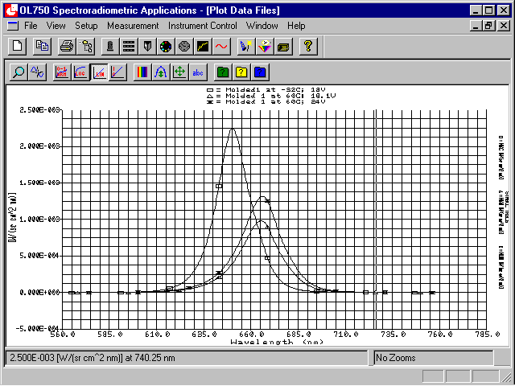
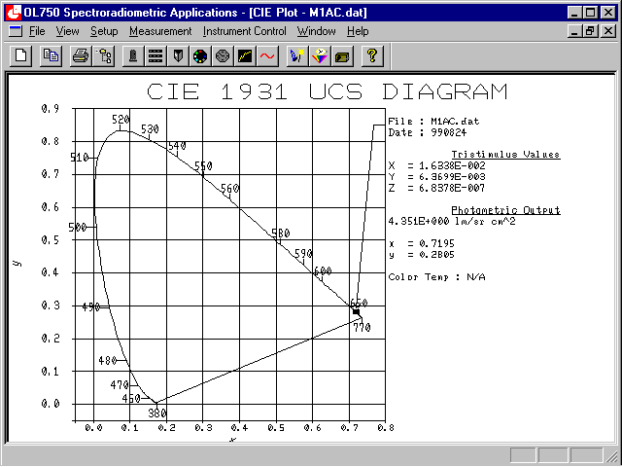
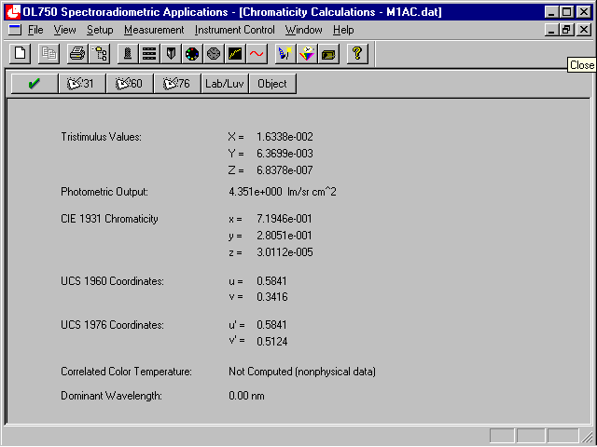
• The OL 754 Windows® Application Software combines data reduction and utility programs with optional application software packages for a completely integrated turnkey system. The software operates on any Microsoft Windows® operating system. The OL 754 Windows® Application Software utilizes full mouse and/or keyboard control for menu selection.
WHAT YOU CAN EXPECT

Slide 5
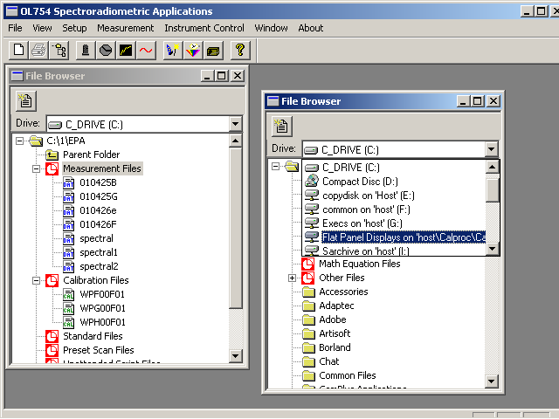
• The smart File Browser opens immediately after the application is started. The browser enables you to customize the computing environment such as opening multiple browser windows for data reduction. The browser sorts and stores measurement, calibration, and standard files in “virtual folders,” eliminating the need for tedious searches in directory hierarchies.
THE FILE BROWSER

Slide 6
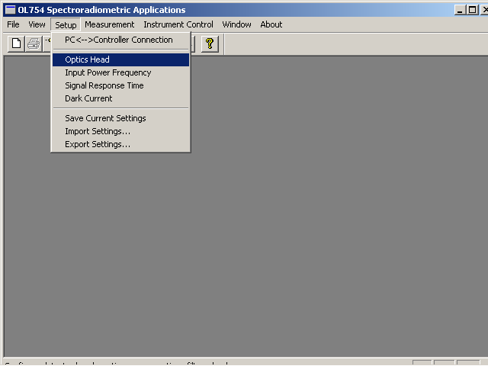
• The Setup Menu enables the user to set or change the OL 754 instrument parameters (i.e., unattended measurement scans signal sampling, rate and signal response times, etc.).
THE SETUP MENU

Slide 7
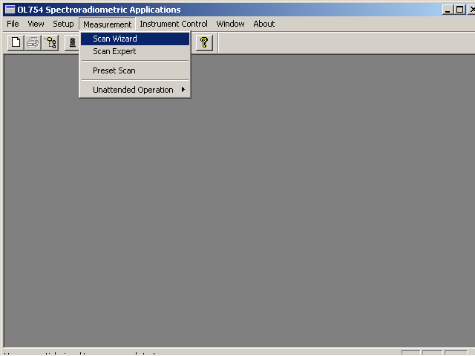
• Scan Wizard assists the novice operator with setting up a measurement. • Expert Scan Mode allows a quick set-up of measurement scans. • Preset Scan is used to recall scan set-ups that have been saved to file. • Unattended Operation allows the PC to control the scan for hours, days, etc.
THE MEASUREMENT MENU

Slide 8
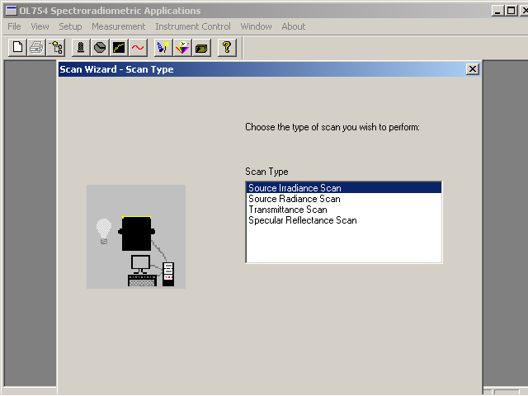
• Each of the four optional measurement application software packages are integrated into the OL 754 Windows® Application Software. Thus, the user can quickly switch from one measurement application to another or switch from a measurement routine to a data reduction routine within the same program.
MEASUREMENT TYPES

Slide 9
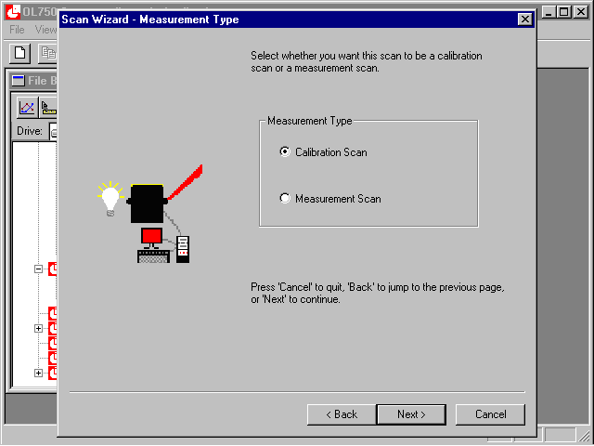
• All of the optional application software packages contain the software needed for performing the spectroradiometer calibration. The Scan Wizard, Expert Scan, or Preset Scan menus can be used to perform the spectral calibration of the spectroradiometer, simply select “Calibration Scan” rather than “Measurement Scan” and a system calibration will be performed.
PERFORMING AN
OL 754 CALIBRATION

Slide 10
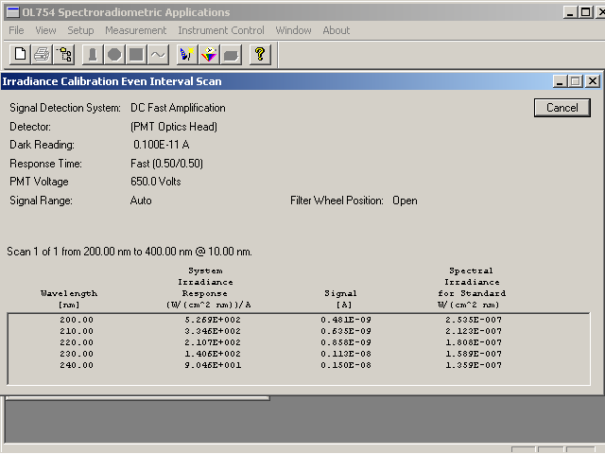
• During the spectral response calibration the display indicates all the relevant information such as the spectral standard values, detector signal, and the subsequent spectral response value at each wavelength data point. Also displayed is information such as the present blocking filter in use, the detector dark current reading taken prior to commencement of the scan, and the response time of the detector.
PERFORMING AN
OL 754 CALIBRATION

Slide 11
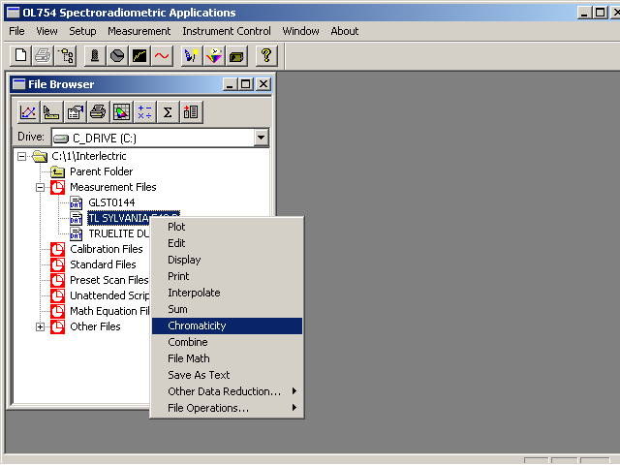
• The software includes a host of file utilities providing calculation of tristimulus values, CIE LAB/LUV, chromaticity coordinates, photometric output, correlated color temperature, color rendering index, etc., and an Export to Excel button for custom report generation.
POWERFUL DATA
REDUCTION UTILITIES

Slide 12
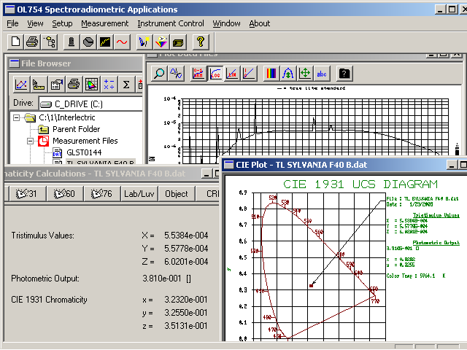
• Graphics include spectral plots in semi-log, linear, and normalized scales, and CIE diagrams. Up to six sets of data may be plotted on one single graph for comparison purposes.
POWERFUL DATA
REDUCTION UTILITIES

Slide 13
• The system illustrated represents just a few of the accessories from Optronic Laboratories, LLC • For more information: Visit our website at OptronicLabs.com Call 407-422-3171 to Contact an Application Engineer
MORE INFORMATION

