Slide 1
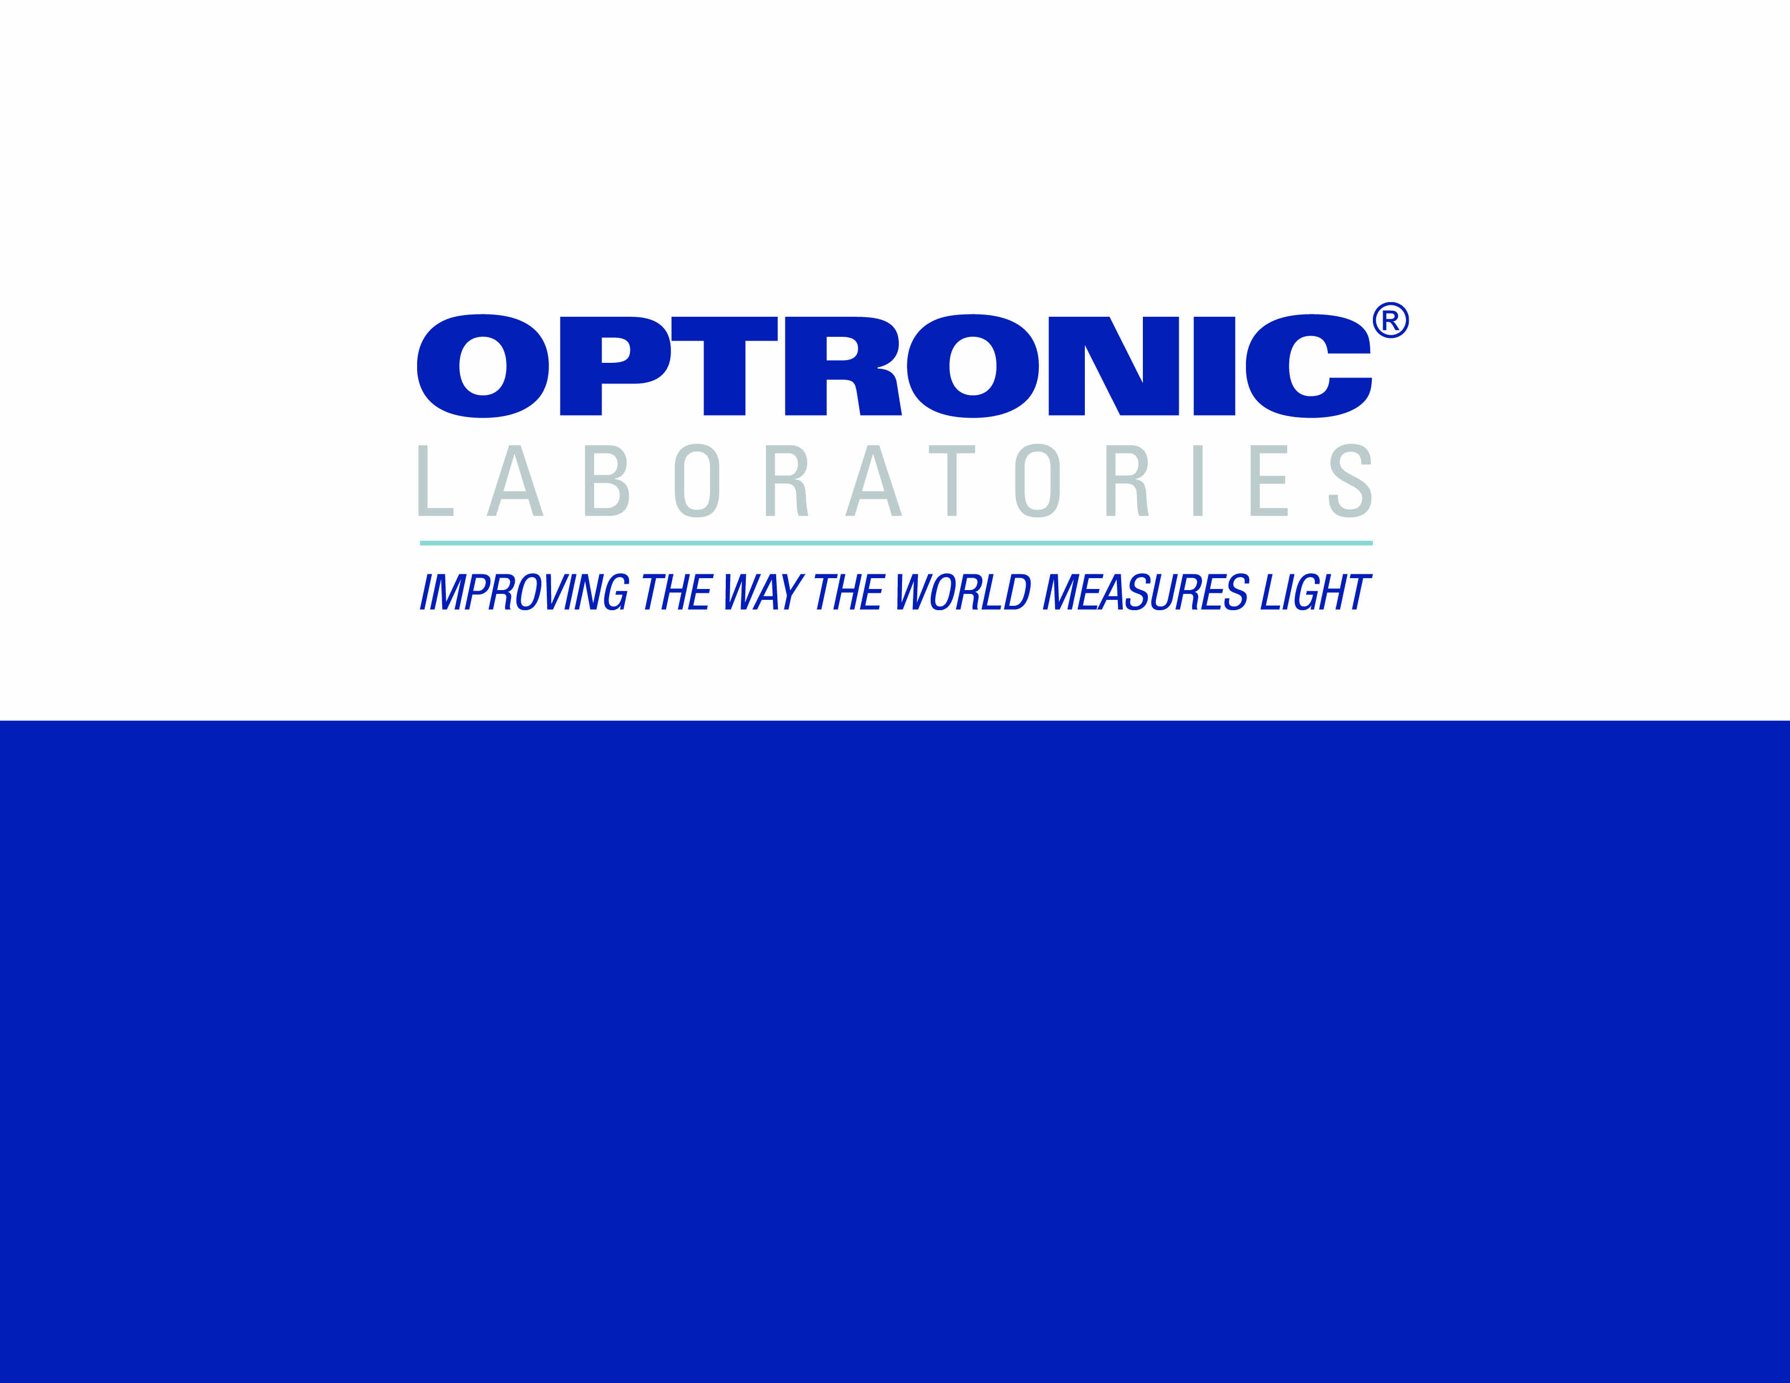
OL 750 Measurement Systems

Slide 2

OUTLINE OF PRESENTATION
• About Optronic Laboratories, LLC
• The OL 750 Series Spectroradiometer
• Source Measurements
• Transmission Measurements
• Reflectance Measurements
• Detector Measurements

Slide 3
ABOUT OPTRONIC LABORATORIES, LLC
• Optronic Laboratories, LLC was established in 1970 by two eminent researchers at NIST (then NBS). Facilities were modeled after NIST, and Optronic Laboratories, LLC achieved a worldwide reputation for excellence in light measurement and calibration.
• Continuing to work closely with NIST, the development of new instruments and techniques at Optronic Laboratories, LLC constantly improves the accuracy and precision of light measurement.
BACKGROUND

Slide 4
OPTRONIC LABORATORIES’ INSTRUMENTS
& SERVICES INCLUDE:
• Training, consultation & advice
BACKGROUND

Slide 5
THE HEART OF ANY SPECTRORADIOMETRIC SYSTEM IS THE MONOCHROMATOR, BUT…
• It must give the right bypass –
- Too large and spectra are distorted
- Too small and signals are low
• It must give high spectral purity (low stray light) so only the wavelength of interest is detected
THE OL SERIES 750 MONOCHROMATORS

Slide 6
• Available in single and double (shown) versions
• F/4 optics for high throughput
• Very low stray light
• Numerous special features for most accurate results
THE OL SERIES 750 MONOCHROMATORS

Slide 7
• Large range of gratings available
• Optimized for high efficiency
• Optimized for wide wavelength range
• Optimized for high resolution
THE OL SERIES 750 MONOCHROMATORS
Tri-grating mounts change gratings automatically

Slide 8
• Range of plug-in input accessories
• Choppers (shown) for IR detectors
• Automatic control of chopper speed and “open” position stop
• Filter-wheel for input attenuation or filtering
THE OL SERIES 750 MONOCHROMATORS
Versatile plug-in chopper or filter wheel input accessories

Slide 9
• Fully automated 11 position blocking-filter wheel
• Includes SHUT position for dark current readings
• Optimized filters for widest wavelength range
THE OL SERIES 750 MONOCHROMATORS
Blocking-filter wheel changes filters automatically

Slide 10
• Gratings diffract light at different angles depending on wavelength
• 400nm will also diffract at the same angle as 800nm
(since 2 x 400 = 800)
• A blocking filter removes the
400nm so just 800nm is left
THE OL SERIES 750 MONOCHROMATORS
Blocking filters:
how they work
Blocking filter
400nm + 800nm
400nm
400nm
800nm
grating

Slide 11
• Light passes into the monochromator through the entrance slit, then onto the first collimating mirror.
THE OL SERIES 750 MONOCHROMATORS

Slide 12
• Collimated (parallel) light is directed onto the grating.
THE OL SERIES 750 MONOCHROMATORS

Slide 13
• The grating diffracts the light, sending each wavelength off at a different angle.
• The desired wavelength is collected by the first focussing mirror….
THE OL SERIES 750 MONOCHROMATORS

Slide 14
• …which focuses it at the middle slit.
• A second collimating mirror collects this beam…
THE OL SERIES 750 MONOCHROMATORS

Slide 15
• …and collimates it onto a second grating.
• Since the second grating is linked to the first, they are at the same angle and hence the same wavelength.
THE OL SERIES 750 MONOCHROMATORS

Slide 16
• This second grating acts like the first, but the spectral purity is increased by many decades.
THE OL SERIES 750 MONOCHROMATORS

Slide 17
• The pure monochromatic light, at the wavelength desired, is then focussed onto the exit slit and emerges from the monochromator
THE OL SERIES 750 MONOCHROMATORS

Slide 18
THE MOST COMMON MEASUREMENTS OF SOURCES INCLUDE:
• Radiance - Light emitted in a particular direction
• Irradiance – Light falling onto a surface
• Total flux – Total light emitted in all directions
SOURCE MEASUREMENT

Slide 19
• Radiance is normally measured with a telescope
• The solid collection angle corresponds to the size of the lens
• The measurement area corresponds to the field-of- view of the telescope
RADIANCE MEASUREMENT
Source
Solid Collection angle
Measurement area

Slide 20
• The term “radiance” in this section also refers to related units such as luminance and radiant intensity
• Radiant intensity applies to small or distant objects that are smaller than the telescope field-of-view
RADIANCE MEASUREMENT
Solid Collection angle
Source
Measurement area

Slide 21
• Optronic Laboratories, Inc. manufactures a large range of telescope, microscope and imaging optic modules for radiance measurements
• To illustrate a typical system for radiance measurement, we will use the OL Series 730-9
Telescopes
RADIANCE MEASUREMENT

Slide 22
• For luminance and radiance of sources from 200 nm to 14,000 nm
THE OL SERIES
730-9 TELESCOPES
Reflex viewing
Wide range of lenses
Adjustable focus

Slide 23
• For luminance and radiance of sources from 200 nm to
14,000 nm
THE OL SERIES
730-9 TELESCOPES
Here is how it works
Light coming from the source…

Slide 24
• For luminance and radiance of sources from 200 nm to
14,000 nm
THE OL SERIES
730-9 TELESCOPES
The sectional drawing shows what happens inside the solid housing
If the mirror is flipped out of the way
…is picked up at some distance and focused by the OL 730-9

Slide 25
• For luminance and radiance of sources from 200 nm to
14,000 nm
THE OL SERIES
730-9 TELESCOPES
The image is sent via the field-of-view aperture to the spectroradiometer

Slide 26
• Putting together an OL 750 radiance system
RADIANCE MEASUREMENT
We start with an OL 750 monochromator
Positive location & easy assembly
And a detector
Then we add the OL 730-9

Slide 27
RADIANCE MEASUREMENT
We have a complete radiance measurement system

Slide 28
• To measure irradiance (or illuminance), a cosine response integrating sphere such as the OL IS-670 is substituted for the OL 730-9
• To measure total flux, a large sphere (typically 18 to 76 inches) is substituted for the OL 730-9
IRRADIANCE AND
TOTAL FLUX MEASUREMENT

Slide 29
IRRADIANCE MEASUREMENT
A complete irradiance measurement system
OL IS-670 near-perfect cosine response integrating sphere

Slide 30
• For transmission, reflection and detector response measurements, a light source at the entrance of the
OL 750 creates monochromatic light at the exit
• The OL Series 740-20 is an ideal light source for most applications
OTHER MEASUREMENTS

Slide 31
• Single and double lamp versions
• UV lamp
- 200nm to 400nm
• Tungsten lamp
- 250nm to 2500nm
• Glowbar
- 1000nm to 30000nm
THE OL SERIES 740-20
LIGHT SOURCES

Slide 32
• Optics match the OL Series
750 Monochromators
• Easy switching from one source …
THE OL SERIES 740-20
LIGHT SOURCES

Slide 33
• Optics match the OL Series
750 Monochromators
• Easy switching from one source …
…TO THE OTHER
THE OL SERIES 740-20
LIGHT SOURCES
Fully automated switching available

Slide 34
• 200 to 30,000 nm coverage
• Monochromatic light prevents sample heating
• Suits a very wide range of standard OL accessories
• Suits many existing and future applications
THE OL 750 + OL 740-20

Slide 35
• Transmittance can be regular (like a window) or diffuse
(like paper)
• Optronic Laboratories, Inc. manufacture a wide range of accessories for regular and diffuse transmittance
• To illustrate a regular transmittance measurement system, we will use the OL Series 740-73 Transmittance Attachment
TRANSMITTANCE
MEASUREMENT

Slide 36
• After a 100% scan (with setup as shown), the sample is placed in the beam
THE OL SERIES 740-73
Sample
Collimated light
Detector

Slide 37
• The ratio of a scan with the sample in place to the 100% scan is the transmittance of the sample
THE OL SERIES 740-73

Slide 38
• When the system is assembled, the transmission of a sample can be measured up to
14,000 nm
THE OL 740-73 +
OL 750 + OL 740-20
Other transmittance accessories are available to cover the range
200 nm to 30,000nm

Slide 39
• Reflectance can be specular (like a mirror) or diffuse (like paper)
• Optronic Laboratories, Inc. manufacture a wide range of accessories for regular and diffuse transmittance
• To illustrate a specular reflectance measurement system, we will use the OL 750-75MA Goniometer Attachment
REFLECTANCE
MEASUREMENT

Slide 40
• Measures direct beam for true absolute results without the need for standard mirrors
THE OL 750-75MA
FOR SPECULAR REFLECTANCE

Slide 41
• Full 10° to 80° angle-of- incidence measurements
• Detector tracks incidence angle or moves free to map other angles
THE OL 750-75MA
FOR SPECULAR REFLECTANCE

Slide 42
• Transmittance at any angle,
0° to 80°
THE OL 750-75MA FOR SPECULAR TRANSMITTANCE

Slide 43
• Detector moves independent of incident angle for BRDF & BTDF measurements
THE OL 750-75MA
FOR BRDF MEASUREMENTS

Slide 44
• If we put these together…
THE OL 750 + OL 740-20
+ OL 750-75MA
Positive location
&
Easy assembly

Slide 45
• Materials can be measured from 200nm to 30,000nm
THE OL 750 + OL 740-20
+ OL 750-75MA

Slide 46
• The OL 750-75MA can be used to map diffuse reflectance by measuring one angle at a time
• To give diffuse reflectance in one measurement however, an integrating sphere is required
DIFFUSE
REFLECTANCE

Slide 47
• Optronic Laboratories, LLC manufacture a range of fixed-angle and Edward Spheres for diffuse reflectance measurements.
• To illustrate a diffuse reflectance measurement system, we will use the OL 750-70 Diffuse Reflectance Attachment.
DIFFUSE
REFLECTANCE

Slide 48
• Diffuse reflectance is measured against a standard
• A scan is run with the standard, then another with the sample
DIFFUSE
REFLECTANCE
Sample

Slide 49
• From a simple viewpoint, the ratio of these scans would indicate the sample reflectance
• However, the throughput of the sphere changes due to the sample
DIFFUSE
REFLECTANCE
CAUTION:
Change in throughput
DO NOT USE
Sample

Slide 50
• Instead, the double beam method should be used
• This involves 4 scans, 3 to calibrate and one to measure
DIFFUSE
REFLECTANCE
Scan 4
Scan 3
Sample

Slide 51
• The scans with the beam directed at the wall of the sphere correct for the throughput changes
• The true reflectance can then be calculated
DIFFUSE
REFLECTANCE
Scan 4
Sample

Slide 52
• Uses the double beam method for accurate values of reflectance
• Software guides the user through the calibration and measurement
THE OL SERIES
750-70
Beam switch mirror
Standard or sample

Slide 53
  • 2 versions of the OL 750-70 are available
  - PTFE sphere coating for
  250nm to 2,500nm
  - Gold sphere coating for
  1,000nm to 30,000nm
THE OL SERIES
750-70
Beam switch mirror
Standard or sample

Slide 54
• If we put these together…
THE OL 750 + OL 740-20
+ OL 750-70
And add a detector
Positive location
&
Easy assembly

Slide 55
• We have a complete system for diffuse reflectance
THE OL 750 + OL 740-20
+ OL 750-70
The light-trap supplied also allows measurements which exclude specular reflections

Slide 56
• In order to characterize their performance in a particular applications, single detectors, array detectors and assemblies often need spectral response to be known
• For example, photopic detectors can be analysed for V(λ) matching
DETECTOR
SPECTRAL RESPONSE

Slide 57
• Measurements are generally consistent with detector use, and may require a large collimated beam, a small spot, a diffuse source or other geometry
• Optronic Laboratories, LLC manufactures a wide range of accessories for most detector measurement requirements, including quantum efficiency
DETECTOR
SPECTRAL RESPONSE

Slide 58
• Optronic Laboratories, LLC provides standard detectors, traceable to NIST and other National Laboratories
• To illustrate a detector spectral response system, we will use the OL 750-10C All Mirror Collimator
DETECTOR
SPECTRAL RESPONSE

Slide 59
• 2 inch diameter beam
• Excellent beam uniformity
• Constant collimation at all wavelengths
THE OL 750-10C

Slide 60
• If we put these together…
THE OL 750 + OL 740-20
+ OL 750-10C

Slide 61
• We have a complete system for detector response
THE OL 750 + OL 740-20
+ OL 750-10C
Then we measure the test detector

Slide 62
• The system illustrated represents just a few of the accessories from Optronic Laboratories, LLC
• For more information:
Visit our website at OptronicLabs.com
Call 407-422-3171 to Contact an Application Engineer
MORE INFORMATION

