Slide 1

OL 731 Smart Sensor:
Palm-Top USB Radiometer/Photometer

Slide 2

• Low cost portable radiometer
• Easily configured via software and filter kits for a variety of applications
• Built-in pre-amplifier (6 decade)
• Built in intelligent firmware with automated gain adjustment
• Signal processing software capabilities
• NIST Traceable Calibration
OL 731 SMART SENSOR

Slide 3
• High-speed USB Interface (RS232/422 available in Phase 2 for use with PocketPCTM)
• Powered via USB
• Can be multiplexed
• ActiveXTM Software Development Kit
• Excel Add-In
OL 731 SMART SENSOR

Slide 4
OL 731 SMART SENSOR
SPECIFICATIONS
OL 731 Specifications (Typical)
Detector | Silicon
Acquisition rate | 500 msec / sample
A/D resolution | 16 bits
Weight | > 0.5 lb.
Operating temperature | 40 - 100°F
Operating humidity | 0 - 90% non condensing
Power Requirement | 5 VDC Via USB connector
User interface | Virtual interface via PC, laptop, or Pocket PC
Amplifier Gain | 10⁴ – 10⁹ Volts/Amp

Slide 5
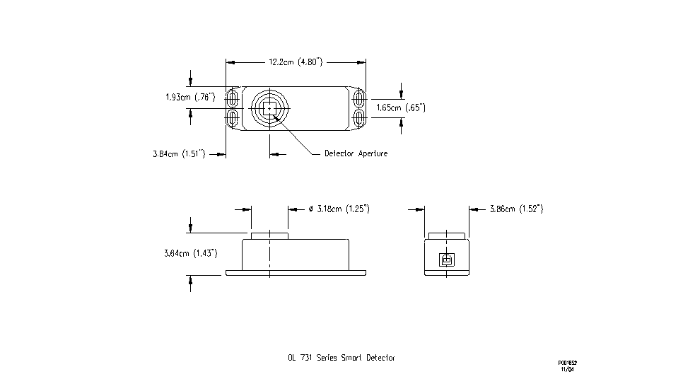
OL 731 SMART SENSOR
DIMENSIONS

Slide 6
RAW SILICON
DETECTOR RESPONSE

Slide 7
  • OEM Production Process Control:
  • Display testing and optimization
  • QC
  • UV Curing
  • Photo resist Exposure
  • Field Applications:
  • Photosynthesis Measurement
  • Medical Applications:
  • Phototherapy
  • Hyperbilirubinemia
TARGET APPLICATIONS

Slide 8
  • OL 730-5-PF Photopic Filter – f1' factor of 4%
  • OL 730-5-RF Radiometric Filter – flat (± 5%) over the wavelength range of 460 nm to 980 nm
  • OL 730-1, -2, -3 Attenuation Filters – 10%, 1%, and 0.1%
  • OL 730-5-XXX Spectral Band pass Filters – Narrow band pass interference filters with peak wavelength transmittance and band pass specified by customer
  • Measurement Accessories – A wide range of cosine collectors and imaging optics are available to suite the measurement application
OL 731 USB SMART
DETECTOR ACCESSORIES

Slide 9
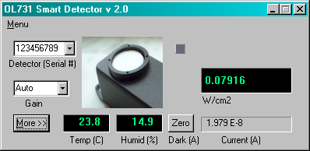
  • OL 731-SDK Software Development Kit (Included) – Windows XP compatible, ActiveX control
OL 731 USB SMART
DETECTOR ACCESSORIES

Slide 10

QUESTIONS

Slide 11
• For more information:
Visit our website at OptronicLabs.com
Call 407-422-3171 to Contact an Application Engineer
MORE INFORMATION

