Slide 1
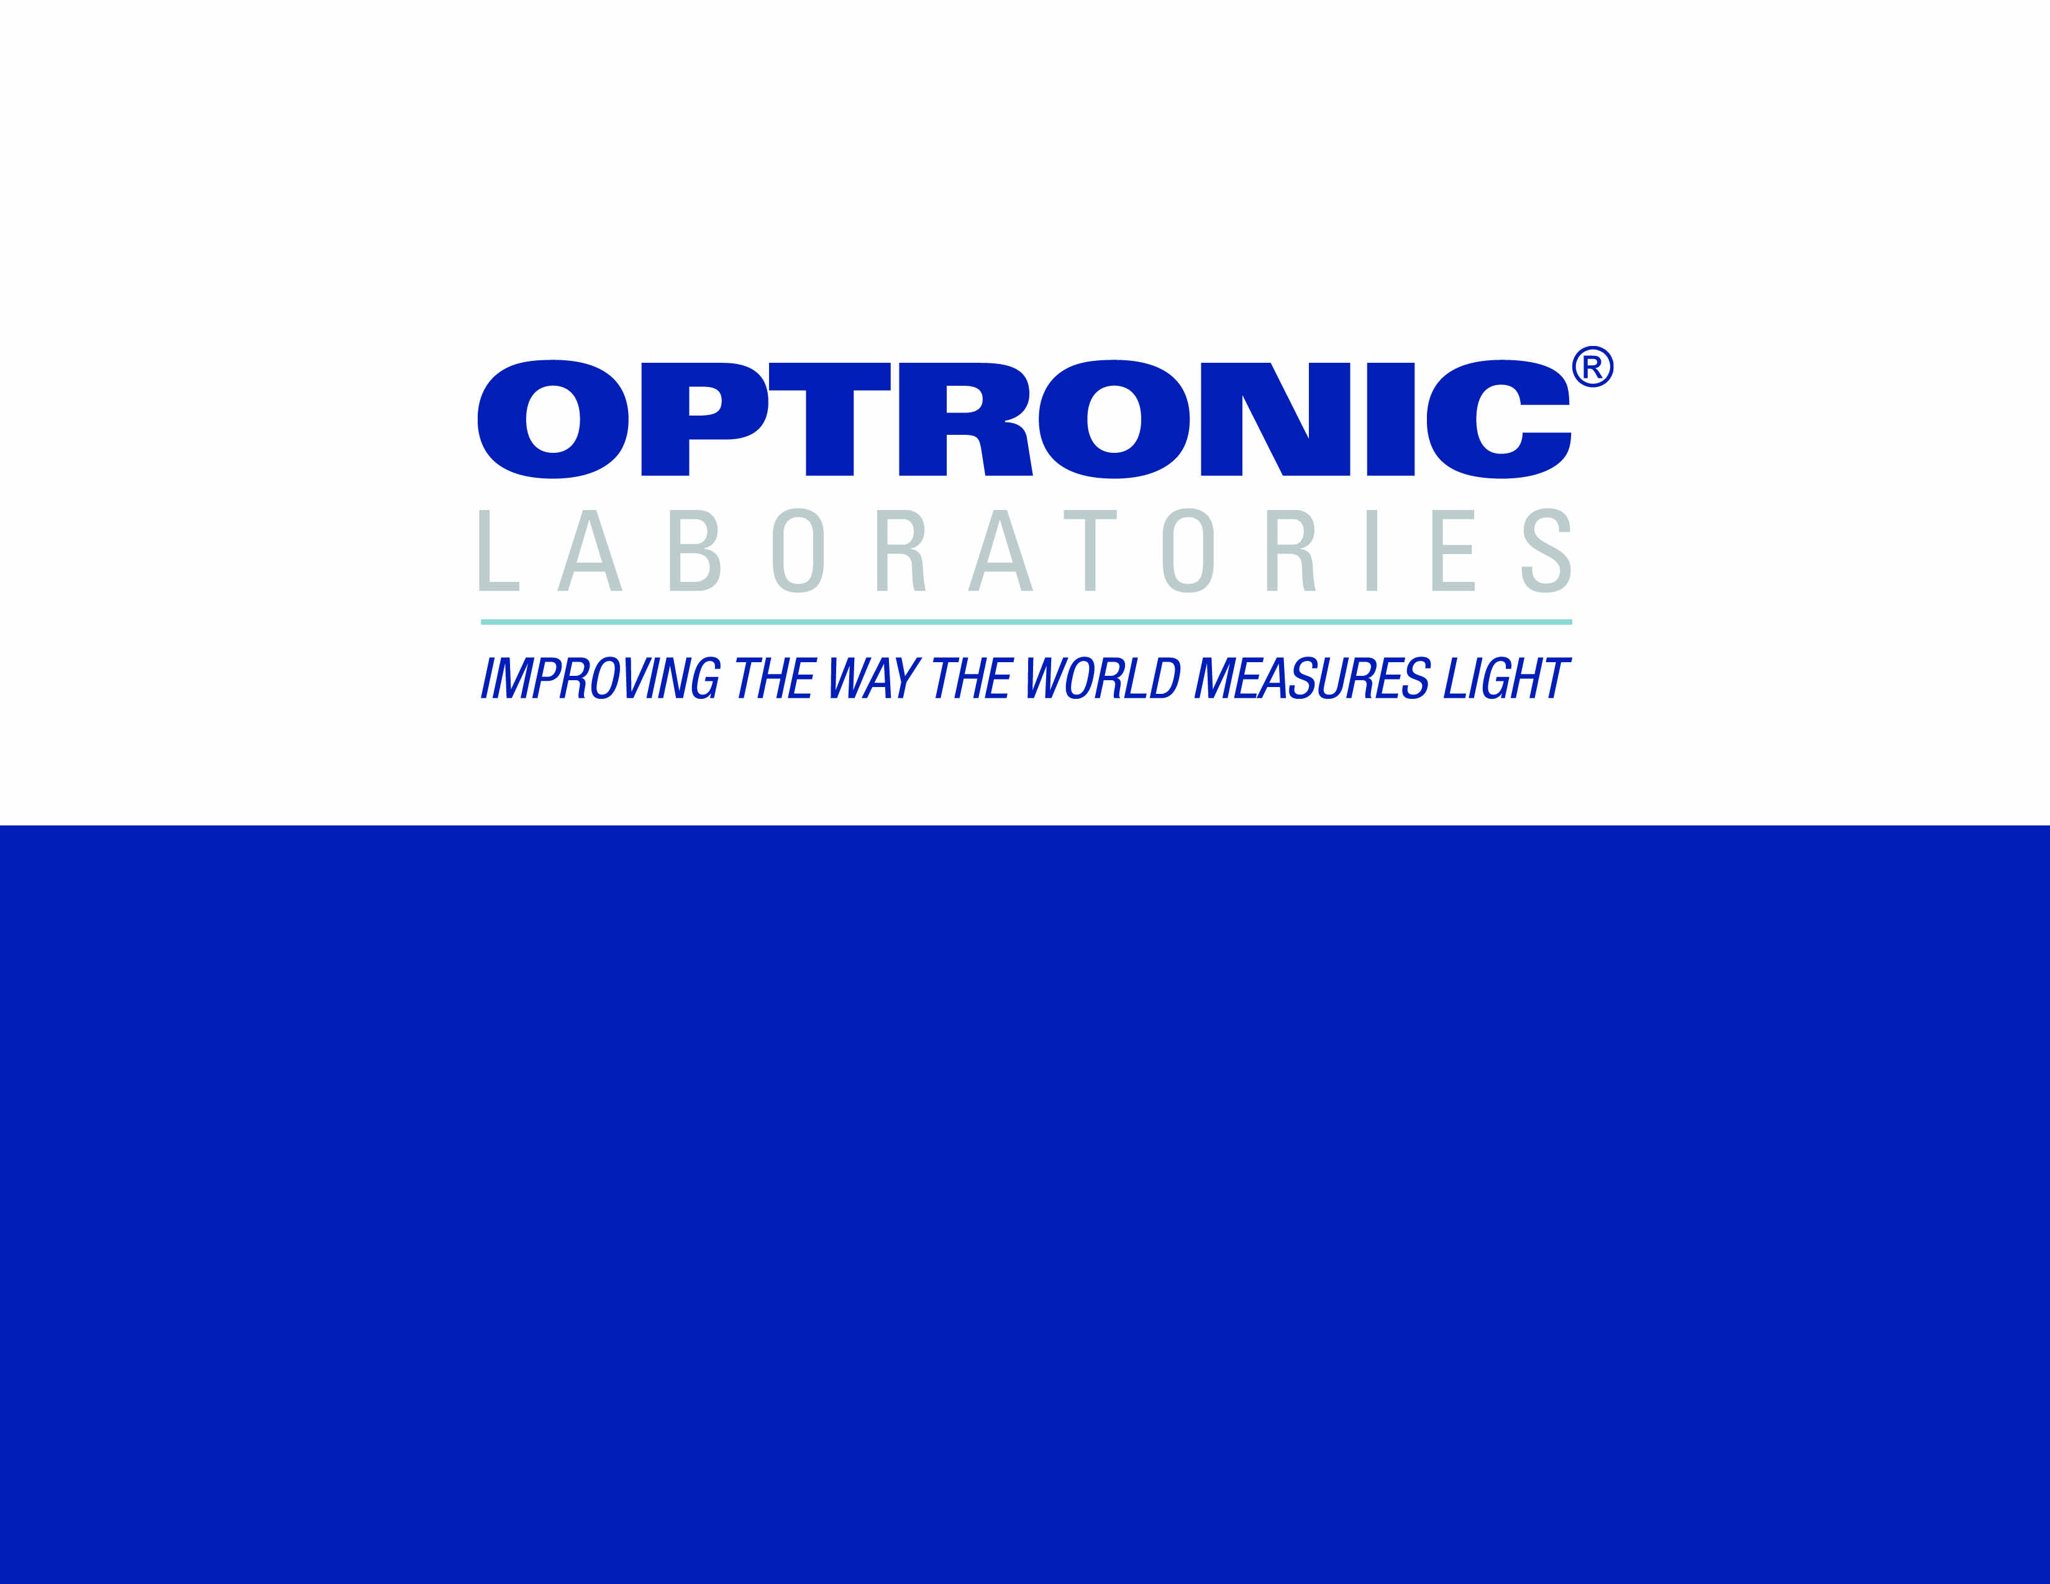
LED MEASUREMENT
INSTRUMENTATION
Notes:
Human sight is not sensitive the polarization state of light. In many ways describing polarization is therefore like describing a sunset to a blind person.

Slide 2
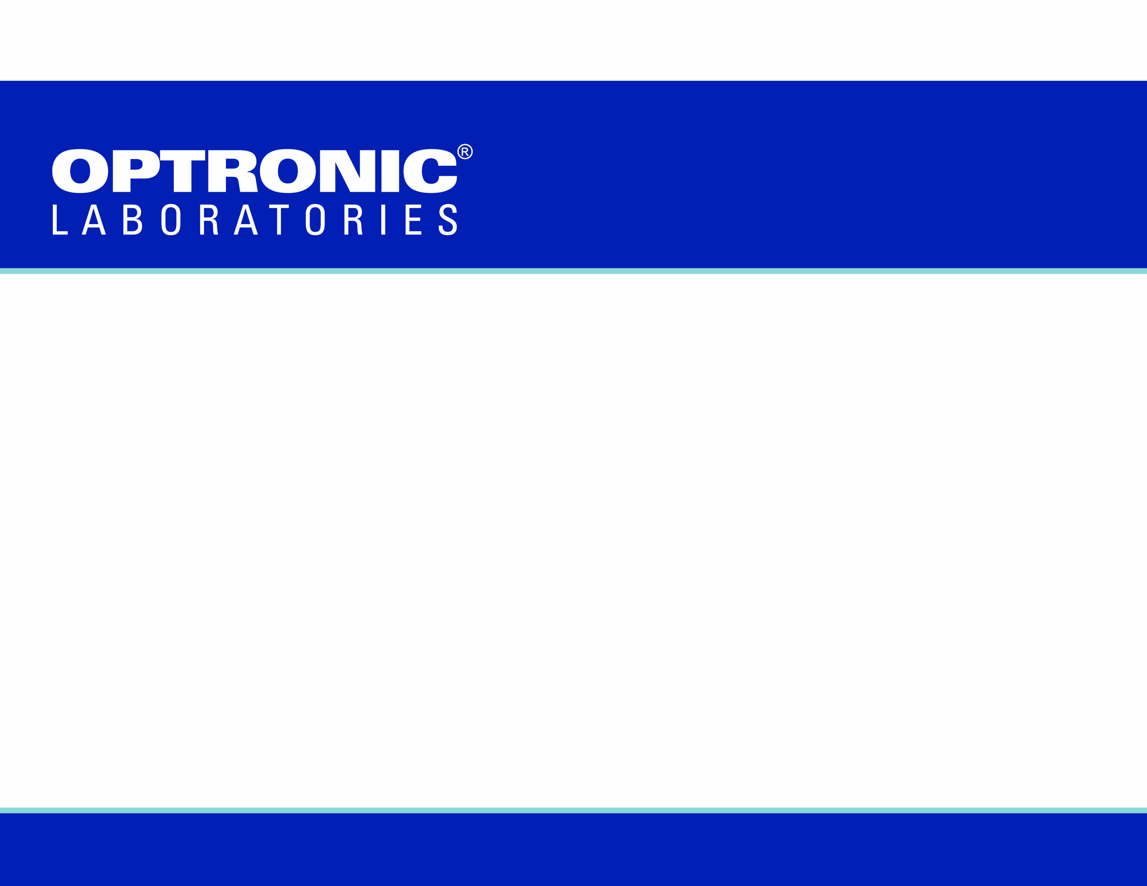
  TYPICALLY, LEDS REQUIRE MANY TYPES OF MEASUREMENT
  • Photopic Quantities
  - A photometer or spectroradiometer is used
  • Radiometric Quantities
  - A radiometer or spectroradiometer is used
  • Wavelength and Chromaticity Quantities
  - A spectroradiometer is used
INTRODUCTION

Slide 3
  THE SAME, OR SIMILAR, INPUT ACCESSORIES ARE USED TO MAKE PHOTOPIC, RADIOMETRIC AND SPECTRORADIOMETRIC MEASUREMENTS.
  THE INPUT ACCESSORY DEFINES THE TYPE AND CONDITIONS OF MEASUREMENT OF:
  • Luminous, radiometric and spectroradiometric intensity
  • Luminance, radiance and spectral radiance
  • Luminous, radiometric and spectroradiometric flux
  • Illuminance, irradiance and spectral irradiance
INTRODUCTION

Slide 4
LUMINOUS, RADIOMETRIC AND SPECTRORADIOMETRIC INTENSITY
• Typically, a baffle tube is used to define the solid measurement angle, though a telescope can be used in some circumstances
BASIC UNITS
• Luminous intensity
- Candela [cd = lm sr⁻¹]
• Radiometric
- W sr⁻¹
• Spectroradiometric
- W sr⁻¹ nm⁻¹
INTRODUCTION

Slide 5
LUMINOUS, RADIANCE AND SPECTRAL RADIANCE
• Typically, a telescope is used to define the area and solid angle of measurement, though a baffle tube can be used in some circumstances
BASIC UNITS
• Luminance
- cd m⁻²
• Radiance
- W sr⁻¹ m⁻²
• Spectral Radiance
- W sr⁻¹ m⁻² nm⁻¹
INTRODUCTION

Slide 6
LUMINOUS, RADIOMETRIC AND SPECTRORADIOMETRIC FLUX
• Typically, an integrating sphere is used to measure total flux (LED at the center of the sphere) and forward (2π) flux (LED at the sphere wall).
Goniometers can also be used
BASIC UNITS
• Luminous Flux
- lm
• Radiometric Flux
- W
• Spectroradiometric Flux
- W nm⁻¹
INTRODUCTION

Slide 7
ILLUMINANCE, IRRADIANCE AND SPECTRAL IRRADIANCE
• A cosine collector, either diffuser or integrating sphere, is used
BASIC UNITS
• Illuminance
- Lux [lux = lm m⁻²]
• Irradiance
- W m⁻²
• Spectral Irradiance
- W m⁻² nm⁻¹
INTRODUCTION
In the following sections, references to photopic quantities implies the radiometric and
spectroradiometric quantities as well.

Slide 8
LUMINOUS INTENSITY
Consider a point source, that emits light equally in all directions.
We can get the luminous intensity [lm sr⁻¹] by measuring the flux [lm] in any given solid angle, dΩ..

Slide 9
LUMINOUS INTENSITY
Now consider a point source that emits more light in some directions than in others.
But it is independent of distance from the source.

Slide 10
EARLY METROLOGISTS USED THIS MODEL TO DEFINE LUMINOUS INTENSITY FOR LEDS. THEY APPLIED TWO MEASUREMENT ANGLES
• 2°
- This corresponds to 0.000957 sr solid angle (≈0.001 sr).
• 6.5°
- This corresponds to 0.01013 sr solid angle (≈0.01 sr).
HOWEVER, RESULTS WERE FOUND TO VARY BETWEEN LABORATORIES
LUMINOUS INTENSITY

Slide 11
LUMINOUS INTENSITY
If the source is NOT a point source..
…AND it is dependent on distance from the source.

Slide 12
METROLOGISTS REALIZED THIS MODEL TO DEFINE “LUMINOUS INTENSITY” IS BETTER FOR LEDS. THEY APPLIED FIXED MEASUREMENT CONDITIONS (CIE PUBLICATION 127)
• Condition A
- This corresponds to 0.001 sr solid angle using the tip of the LED as the point of origin.
• Condition B
- This corresponds to 0.01 sr solid angle using the tip of the LED as the point of origin.
LUMINOUS INTENSITY

Slide 13
AVERAGED LED INTENSITY
Condition A
31.6 cm
Mechanical axis
1 cm² circular aperture
dΩ = 0.001 sr

Slide 14
AVERAGED LED INTENSITY
Condition B
10.0 cm
Mechanical axis
1 cm² circular aperture
dΩ = 0.01 sr

Slide 15
Conditions A and B do not correspond to strict definitions of luminous intensity, so the term “averaged LED intensity” is used.
Most laboratories get agreement on LED measurements using conditions A and B.
However, luminous intensity is just one type of measurement required, and conditions for other types may also need to be fixed to give agreement.
• It helps to understand the optical properties of LEDs in setting conditions of measurement.
AVERAGED LED INTENSITY

Slide 16
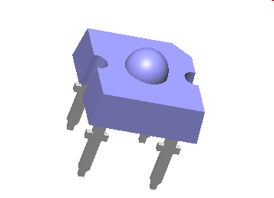
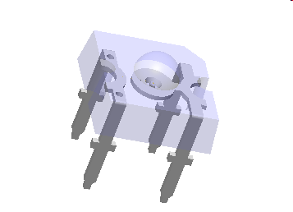
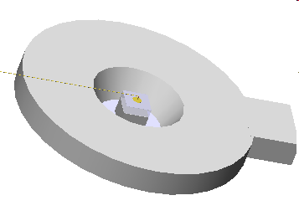
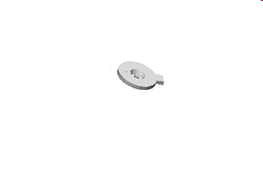
LED OPTICAL PROPERTIES
LEDs are not just chips. They are housed in a complex structure to maximize effective intensity
Cup
Package
Die
Cup/Die
Lead frame

Slide 17
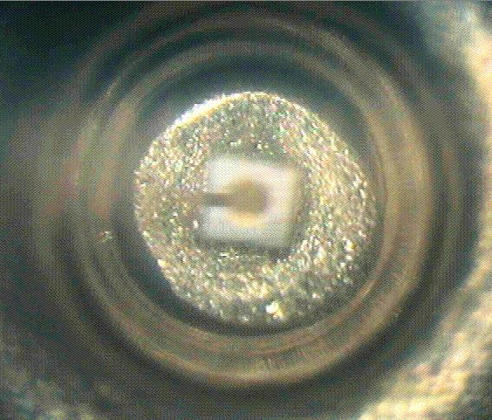
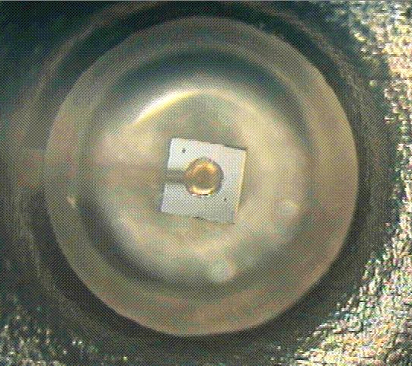
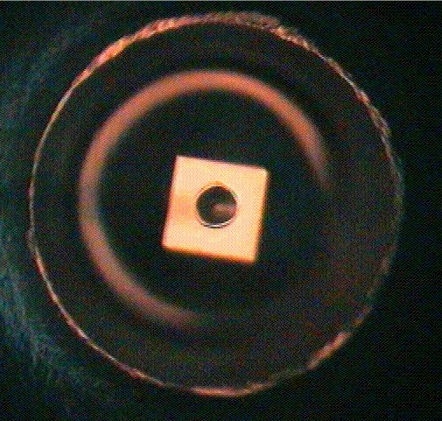
LED OPTICAL PROPERTIES
Lit
Focus at bottom of the cup
Focus at top
of the cup

Slide 18
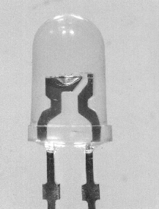
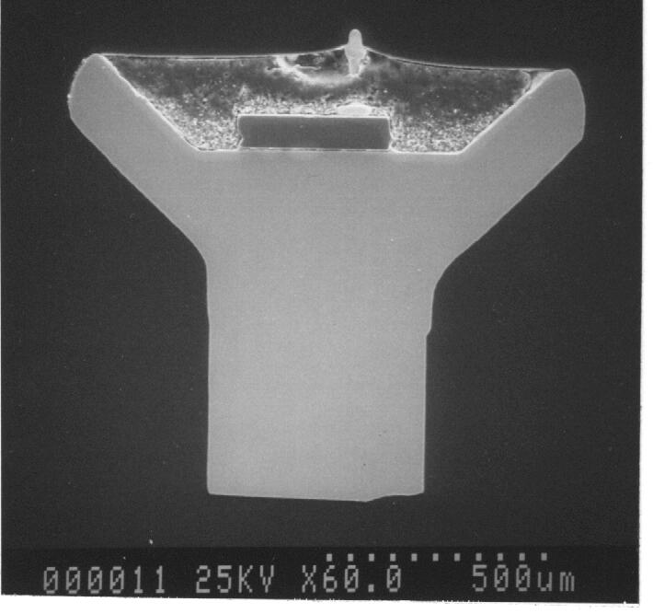
LED OPTICAL PROPERTIES
The cup reflects light from the sides of the chip
The LED sides are tapered

Slide 19
LEDS COME IN MANY PACKAGES, FROM SINGLE CHIP TO SOPHISTICATED MULTI-DIRECTIONAL ASPHERIC LENS DESIGNS.
THEY MAY INCLUDE LENSES, COLORED MATERIALS, DIFFUSERS AND PHOSPHORS, ALL OF WHICH CAN ALTER THE SPATIAL AND SPECTRAL DISTRIBUTION RELATIVE THE THE BASIC CHIP.
PACKAGES MAY INCLUDE CHIPS OF DIFFERENT SIZE, DIFFERENT TYPES AND DIFFERENT LOCATIONS.
PACKAGES AND CHIP LOCATIONS MAY HAVE DIFFERENT MECHANICAL TOLERANCES.
LED OPTICAL PROPERTIES
We will concentrate on what is arguably the most common package to illustrate basic principles.
e.g. T 1-1/4

Slide 20
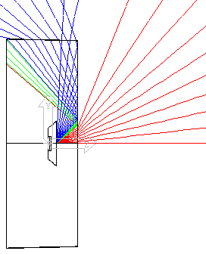
LED OPTICAL PROPERTIES
If we do a ray-trace of light from the LED, we can see there is emission from the front surface (red), side walls (blue) and rear surface (green).
This is for a cut back LED with flat surface. Now if we add the lens surface…

Slide 21
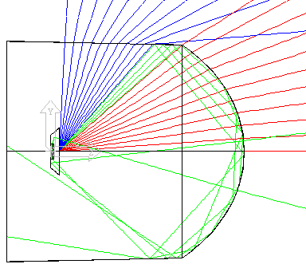
LED OPTICAL PROPERTIES
If the LED body length is now increased…

Slide 22
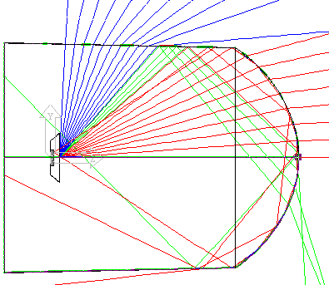
LED OPTICAL PROPERTIES
Total internal reflection components are increased. Some of these components now exit the lens surface at high angles.

Slide 23
LED OPTICAL PROPERTIES
We can see these components if a screen is placed in front of the LED.

Slide 24
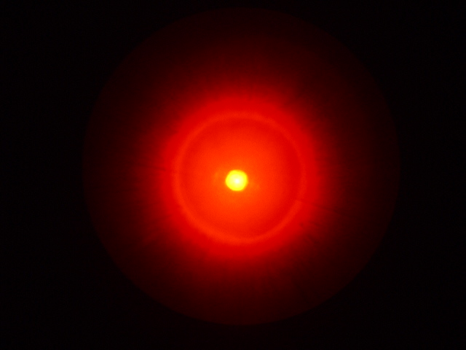
LED OPTICAL PROPERTIES
Touching the side wall blocks this component
side wall
lens
internal reflection

Slide 25
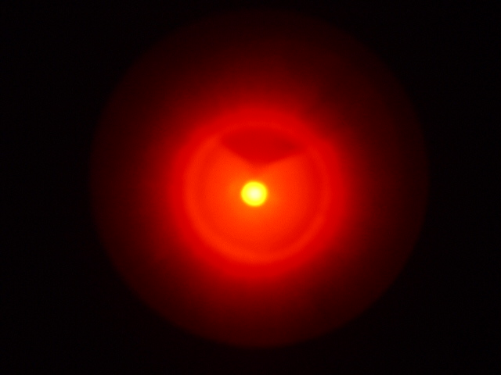
LED OPTICAL PROPERTIES
side wall

Slide 26
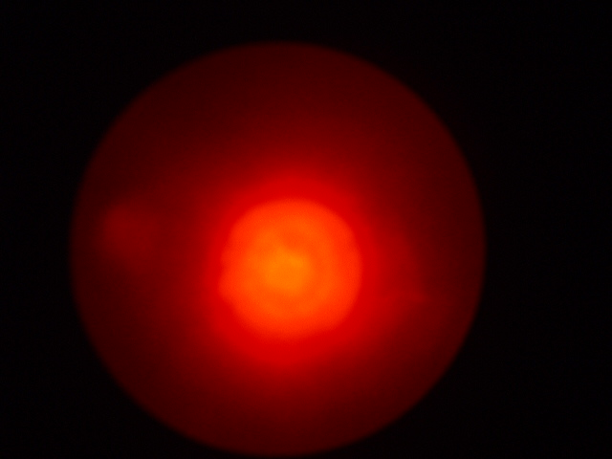
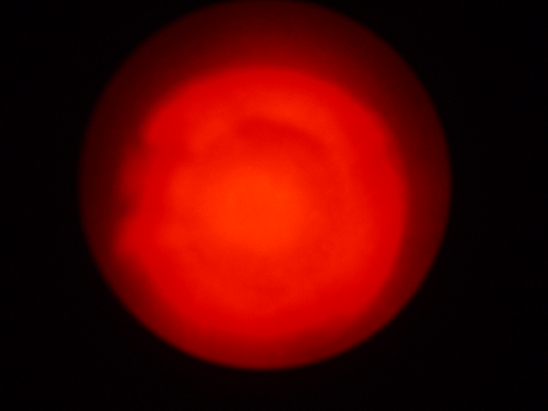
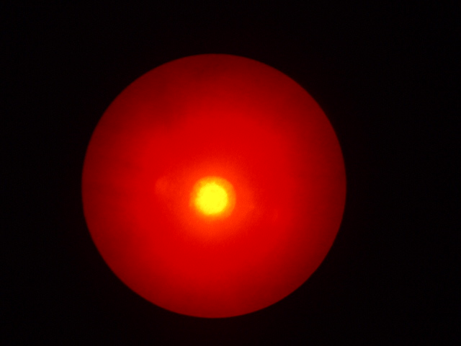
LED OPTICAL PROPERTIES
The pattern on the screen varies with distance
die
cup
Although it is not focussed, we can clearly see the cup/die structure on the screen.

Slide 27
LED OPTICAL PROPERTIES
When measuring the LED, the result depends critically on the measurement cone angle, dΩ…

Slide 28
LED OPTICAL PROPERTIES
This is why Conditions A and B define:
The cone angle
The distance
The orientation

Slide 29
GONIOMETRY
dΩ
θ
We can map the angular properties of a source by measuring at all values of θ and ϕ.
However, this assumes the source is a point object which is at the center of rotation.
ϕ

Slide 30
GONIOMETRY
Recall the ray trace. If we follow these rays backward…
…they seem to come from an area behind the LED

Slide 31
GONIOMETRY
Now if we do the same for the side wall rays…
…they seem to come from a different area

Slide 32
GONIOMETRY
Now the high angle rays…
2
1
3
So we can define at least 3 areas of “apparent” emission

Slide 33
GONIOMETRY
Suppose we map the LED using the tip as the rotation center…
At even larger angles,
region 2 dominates
As the angle increases, region 2 contributes
At extreme angles,
region 3 now dominates
At small angles, most of the intensity is from region 1.

Slide 34
GONIOMETRY
θ_{e} ≈ θ_{s}
θ_{e}
Because regions 1and 2 are not at the center of rotation, the effective angle, θ_{e}, differs from the set angle, θ_{s.}
If a circular 1 cm² detector is used at a radius of 316mm, and rotation is about the tip, as shown, it ties in with Condition A averaged LED intensity at θ=0.
θ_{s}
θ_{s}
θ_{e}

Slide 35
LUMINANCE
LUMINANCE, RADIANCE AND SPECTRAL RADIANCE
  • Typically, a telescope is used to define the area and solid angle of measurement, though a baffle tube can be used in some circumstances.
BASIC UNITS
  • Luminance
    - cd m⁻²
  • Radiance
    - W sr⁻¹ m⁻²
  • Spectral Radiance
    - W sr⁻¹ m⁻² nm⁻¹

Slide 36
LUMINANCE
An aperture then isolates the part of the image to be measured.
The LED emits light.
The telescope refocuses it to give an image.

Slide 37
LUMINANCE
Solid Collection Angle
• The size of the lens defines the solid collection angle.
• The measurement area corresponds to the aperture at the image of the telescope.
• The source MUST be bigger than the measurement area.
Source
Measurement Area

Slide 38
LUMINANCE
• Two main types of telescope exist for this application
  Reflex Telescopes
The sectional drawing shows what happens inside the solid housing.
The reflex mirror lets the user see what is being measured.
Light from the source…
If the mirror is flipped out of the way…
…is focussed by the telescope.

Slide 39
LUMINANCE
• Two main types of telescope exist for this application
  Reflex Telescopes
The image is directed onto the aperture for measurement .

Slide 40
LUMINANCE
• Two main types of telescope exist for this application
  Direct Viewing Telescopes
The mirror and aperture are combined so the area being measured is viewed directly.
The “missing” portion is sent to the detector.
Image appears with a “missing” circular area
(the aperture).
Object

Slide 41
LUMINANCE
REFLEX TELESCOPE
DIRECT VIEWING TELESCOPE
• Relatively inexpensive
• If the viewing optics and aperture are not perfectly equivalent it gives:
  Alignment errors
  Parallax errors
• No cross-checks which aperture is being used
• Aperture in image plane
• Costs more
• Since the image and aperture are viewed together there are:
  No alignment errors
  No parallax errors
• The size of the aperture is seen with the image
• Aperture at an angle to the image plane

Slide 42
LUMINANCE
• For large, uniform, Lambertian sources, luminance measurements are generally:
  Insensitive to focus of the telescope
  Insensitive to position of the measurement area
  Insensitive to rotation of the telescope axis
  Insensitive to lens or measurement area size
  Insensitive to the source/telescope distance
• For single LED packages, luminance measurements are just the opposite:
  They are extremely sensitive to everything

Slide 43
LUMINANCE
Now we add a telescope lens.
This co-dependence means that defining the telescope lens size and position also defines the measurement area and position - and vise versa.
We can see the position on the object and the angular properties are related

Slide 44
LUMINANCE
If the lens was masked to the size and position of this circle, only the corresponding point on the object would be visible in the image.

Slide 45
LUMINANCE
Recall the image on the screen from the LED…
If the telescope lens was placed here only an image of part of the cup could be obtained, since there is no light from the rest of the chip.

Slide 46
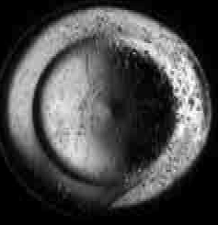
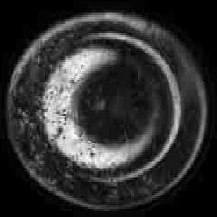
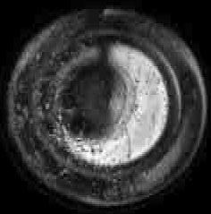
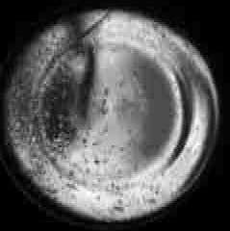
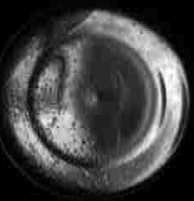
LUMINANCE
We can see this effect if we take a CCD camera, and rotate it about the LED. Only part of the chip is imaged.
The central contact is clearly recognizable.
θ = 0°
θ = 1°
θ = 2°
θ = 3°
θ = 4°

Slide 47
LUMINANCE
• Why not use a large lens to collect all the light and give a full image?
  No reason, provided it is recognized that the luminance measured is the average of:
    The measurement area, regardless how light within the area is distributed.
    The measurement cone angle, dΩ, regardless of the angular properties of the LED.
  NOTE: Larger lenses make alignments less critical.
• The measured luminance values with large lenses will always be lower than small lens values.

Slide 48
LUMINANCE
• Which luminance value is correct?
  MOST of them!
    If the luminance measurement is recognized as being an average over a particular area and a particular solid angle.
  However, the co-dependence of spatial and angular properties makes it difficult to define the “true” luminance.

Slide 49
LUMINANCE
• If the LED is given a diffuse outer surface, that surface becomes the effective source.
  Measuring luminance is a lot easier.
• If a “light” roughening, to give partial diffusion is applied.
  Measuring luminance is a lot harder, since the surface to be measured cannot easily be identified.

Slide 50
LUMINANCE
Care must be taken to avoid “sampling” errors.
This is the measurement of different numbers of LEDs depending on position of the aperture.
This is the measurement of different numbers of LEDs depending on position of the aperture.

Slide 51
LUMINANCE
If the measurement is of a large enough area…
However, although measured at greater distances, the luminance may still have angular restrictions and is the average of both LED and inter-LED areas.
Sampling errors become negligible.

Slide 52
TOTAL FLUX
• Luminous, radiometric and spectroradiometric flux
  Typically, an integrating sphere is used to measure total flux (LED at the center of the sphere) and forward (2π) flux (LED at the sphere wall). Goniometers can also be used.
• Basic Units:
  Luminous flux
    lm
  Radiometric flux
    W
  Spectroradiometric flux
    W nm⁻¹

Slide 53
TOTAL FLUX
• An integrating sphere has several interesting properties:
  Any part of the sphere surface “sees” all other parts of the sphere surface equally.
    This means a detector at any point on the surface can measure the total power in the entire sphere.
  Reflections from the sphere wall add to the lamp power, giving more power inside the sphere than the lamp is generating.

Slide 54
TOTAL FLUX
• The lamp is placed in the center.
• A baffle prevents direct light hitting the detector.
• The sphere walls and baffle are highly reflective.
Lamp
Detector
Baffle

Slide 55
TOTAL FLUX
• Light from the lamp hits the sphere wall equally in almost all directions…

Slide 56
TOTAL FLUX
• Light from the lamp hits the sphere wall equally in almost all directions…
• But there are variations in sphere response.
Shadow area
Partial Shadow area

Slide 57
TOTAL FLUX
• In these shadow areas, the “first strike” (light directly from the lamp) is not fully measured.
• A sphere cannot have PERFECT response.
Shadow area
Partial Shadow area

Slide 58
TOTAL FLUX
• Although perfect response is not attainable with this design, practical spheres can come very close.
• How close they come depends on attention to small details of design.

Slide 59
TOTAL FLUX
0.5 m sphere
• Response is best viewed on a radar graph.
• Response varies with sphere size and reflectivity.
• If a reflectivity of 95% is used…

Slide 60
TOTAL FLUX
1.0 m sphere
• Response is best viewed on a radar graph.
• Response varies with sphere size and reflectivity.
• If a reflectivity of 95% is used…

Slide 61
TOTAL FLUX
2.0 m sphere
• Response is best viewed on a radar graph.
• Response varies with sphere size and reflectivity.
• If a reflectivity of 95% is used…

Slide 62
TOTAL FLUX
• A reflectivity of 98% or more is more common for US manufactured spheres.

Slide 63
TOTAL FLUX
• Some European standards recommend 80% reflectivity.
• There are good reasons for this, but geometric response is not one of them.
Note the higher response in places

Slide 64
TOTAL FLUX
• This high response is caused by reflections from the detector side of the baffle.

Slide 65
TOTAL FLUX
• This high response is caused by reflections from the detector side of the baffle.
• It is present in all spheres, but some are much worse than others.

Slide 66
TOTAL FLUX
• All the prior sphere responses had one thing in common:
  The detector had a cosine collector on it.
• If we remove the cosine collector…
... the response of even the best sphere is destroyed.

Slide 67
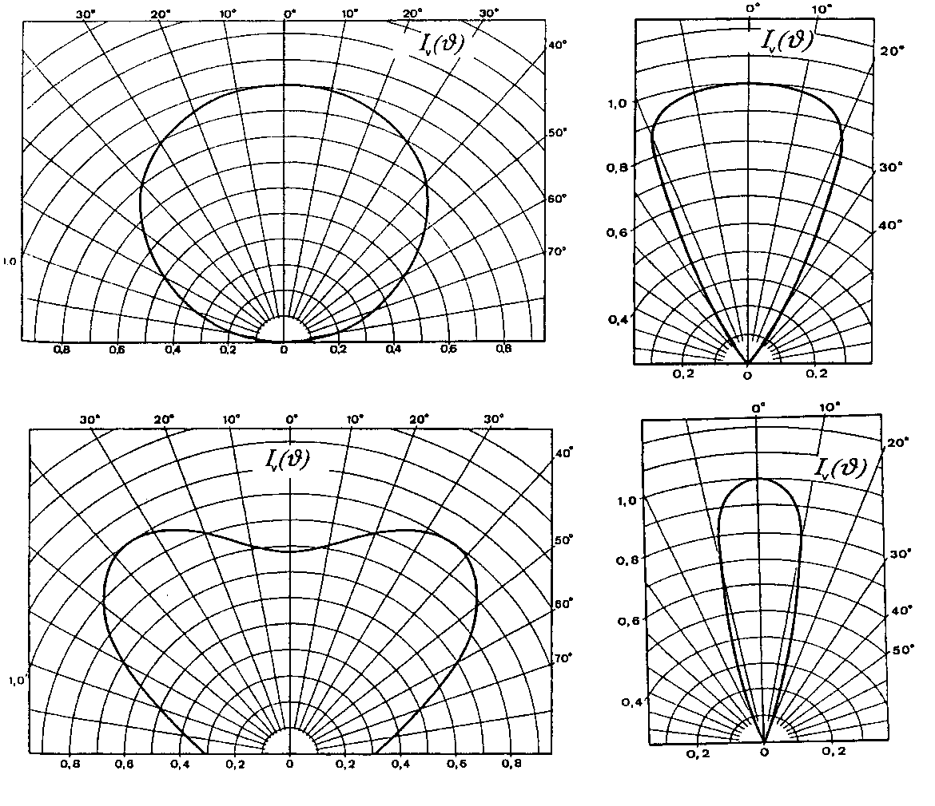
TOTAL FLUX
• LEDs are usually highly directional.

Slide 68
TOTAL FLUX
• A sphere has areas of uniform response (green).
• And non-uniform areas (red).
• If the source is highly directional, it should be pointed at a green area for the best results.

Slide 69
TOTAL FLUX
• The green area is bigger for larger spheres.
• The red area is bigger for larger baffles.

Slide 70
TOTAL FLUX
• Geometrically, the highest accuracies are obtained by orienting LEDs so the maximum output is directed at areas of uniform response.
• Highly reflective coatings give much lower geometrical errors, regardless of orientation, than less reflective coatings.

Slide 71
TOTAL FLUX
However,
• Anything placed inside spheres, including lamps, holders, sockets and cables, can absorb light and change the sphere throughput.
• The higher the reflectivity of the sphere, the bigger the change to throughput when something is placed inside.

Slide 72
TOTAL FLUX
Here, the effective reflectivity is changed by just 0.25%.

Slide 73
TOTAL FLUX
• This example is for a black spherical object in the center of the sphere.
• Actual changes will depend on the object’s reflectance, shape and position in the sphere and can be larger than shown.

Slide 74
TOTAL FLUX
If we look at this pictorially, the size of an LED relative to the sphere, in order to change the throughput of the sphere by 1%, depends on its reflectivity…
99%
90%
0%

Slide 75
TOTAL FLUX
• The lamp or LED used in calibration and the LED to be measured are rarely the same.
• Different changes in throughput between these lamps will mean results will be wrong unless throughput changes are also measured.

Slide 76
TOTAL FLUX
• An auxiliary lamp, which is housed permanently in the sphere, is used to measure changes in throughput.
• For luminous flux or radiant flux, best results are with an auxiliary lamp the same as the LED to be measured.
• For spectral flux, a white light source is best.
Auxiliary Lamp

Slide 77
TOTAL FLUX
• The auxiliary lamp is powered up while the standard or test lamp is in the sphere.
  But not switched on.
• The ratio of signals is the change in throughput.
  This is part of the calibration procedure.
Auxiliary Lamp

Slide 78
TOTAL FLUX
• Good total flux measurements require:
  A large high reflectivity sphere.
  Small, well designed, baffles.
  A cosine collection detector at the sphere wall.
  An auxiliary lamp.

Slide 79
TOTAL FLUX
• It also helps to have:
  Uniform measurement procedures.
    e.g. keep a constant time between powering up an LED and measuring it.
  Dedicated software to guide the user through calibration and measurement.
  Accurate power supplies for lamps and LEDs.
  National Standard Laboratories’ (NSLs’) traceable calibration lamps.

Slide 80
2π Flux
• Many measurements of luminous flux place the LED in a port on the side wall of the sphere.
  This is called forward-looking or 2π luminous flux.
• It is not equivalent to “total” luminous flux since:
  Not all light is measured.
  What should be measured is poorly defined.
  Interactions with the local sphere wall can lead to errors.
  Some spheres do not use auxiliary lamps.

Slide 81
2π Flux
Here is an example of LEDs measured in
“2π” flux (without auxiliary lamp) and total flux (with auxiliary lamp) conditions.
This is red epoxy.
These are clear epoxy.

Slide 82
2π Flux
But this assumes the LED is a point source, and we know this is incorrect.
Any light forward of this plane should be OK as a definition.

Slide 83
2π Flux
Recall the LED distribution.
It also depends on the size of the port opening.
What we measure depends critically on location.

Slide 84
INTRODUCTION
• Illuminance, irradiance and spectral irradiance
  A cosine collector, either diffuser or integrating sphere, is used
• Basic Units:
  Illuminance
    Lux [lux = lm m⁻²]
  Irradiance
    W m⁻²
  Spectral Irradiance
    W m⁻² nm⁻¹

Slide 85
ILLUMINANCE
• Illuminance is the light flux falling onto an area of surface.
• The light can come from any direction, and may be from multiple sources.
The total light hitting the area must be measured.

Slide 86
• Apart from noting that the illuminance depends on measurement aperture and position, we should note:
  Illuminance is not really a property of a LED.
    The method of measurement is independent of the position, orientation or distance of the source(s).
  Single LEDs are rarely used in general lighting.
    The illumination provided by an LED “lamp,” which contains several elements, is likely to be more uniform.

Slide 87
DISCUSSIONS
• All of the measurements discussed can give different results depending on the conditions applied.
  If two laboratories get different values for the same LED, it may be they are measuring different conditions.
  If the same laboratory gets different results for the same LED measured on different occasions, it may be the conditions are inappropriate.
    Or it could be that a parameter not considered, e.g. rotation of the LED about the mechanical axis, needs to be part of the conditions.

Slide 88
DISCUSSIONS
• As with other industries, measurements should be related to how the LEDs are applied.
  What is the significance of the LED measurements if a bezel is added later?
• In replacing traditional sources with LED “equivalents,” e.g. traffic lights, some of the traditional parameter definitions do not work with LEDs.
  How should we interpret LED results when measured to the standards of existing applications?

Slide 89
DISCUSSIONS
• Properly constructed, stable LEDs can be calibrated, traceable to existing NSL radiance, irradiance and luminous flux standards.
• NSL traceable calibrated LEDs make excellent standards to calibrate photometric and radiometric instruments for LED measurements.
  They can have spectral and angular distributions similar to the LED being measured.
  However, a calibrated LED is required for each type of LED measured.

Slide 90
DISCUSSIONS
• Calibrated LED standards are not suited to the calibration of spectroradiometric instruments.
  The intensity decreases rapidly outside a narrow band of wavelengths.
  Uncertainties in the calibration and measurement generally increase relative to original NSL lamps.
• For calibration of spectroradiometric instruments, a broadband NSL traceable radiance, irradiance or luminous flux standard should be used.
  Calibrated LEDs still make excellent verification artifacts for spectroradiometric instruments.

Slide 91
DISCUSSIONS
• Thanks to Optical Research Associates:
  For letting me use their great LED pictures and ray-traces.
    And to Radiant Imaging
      The original source of some of the pictures.
• Special thanks to Dave Jenkins, Andrew Riser and William Cassarly (ORA)
  For sending me those pictures.

Slide 92
• The system illustrated represents just a few of the accessories from Optronic Laboratories, LLC
• For more information:
Visit our website at OptronicLabs.com
Call 407-422-3171 to Contact an Application Engineer
MORE INFORMATION

