Slide 1
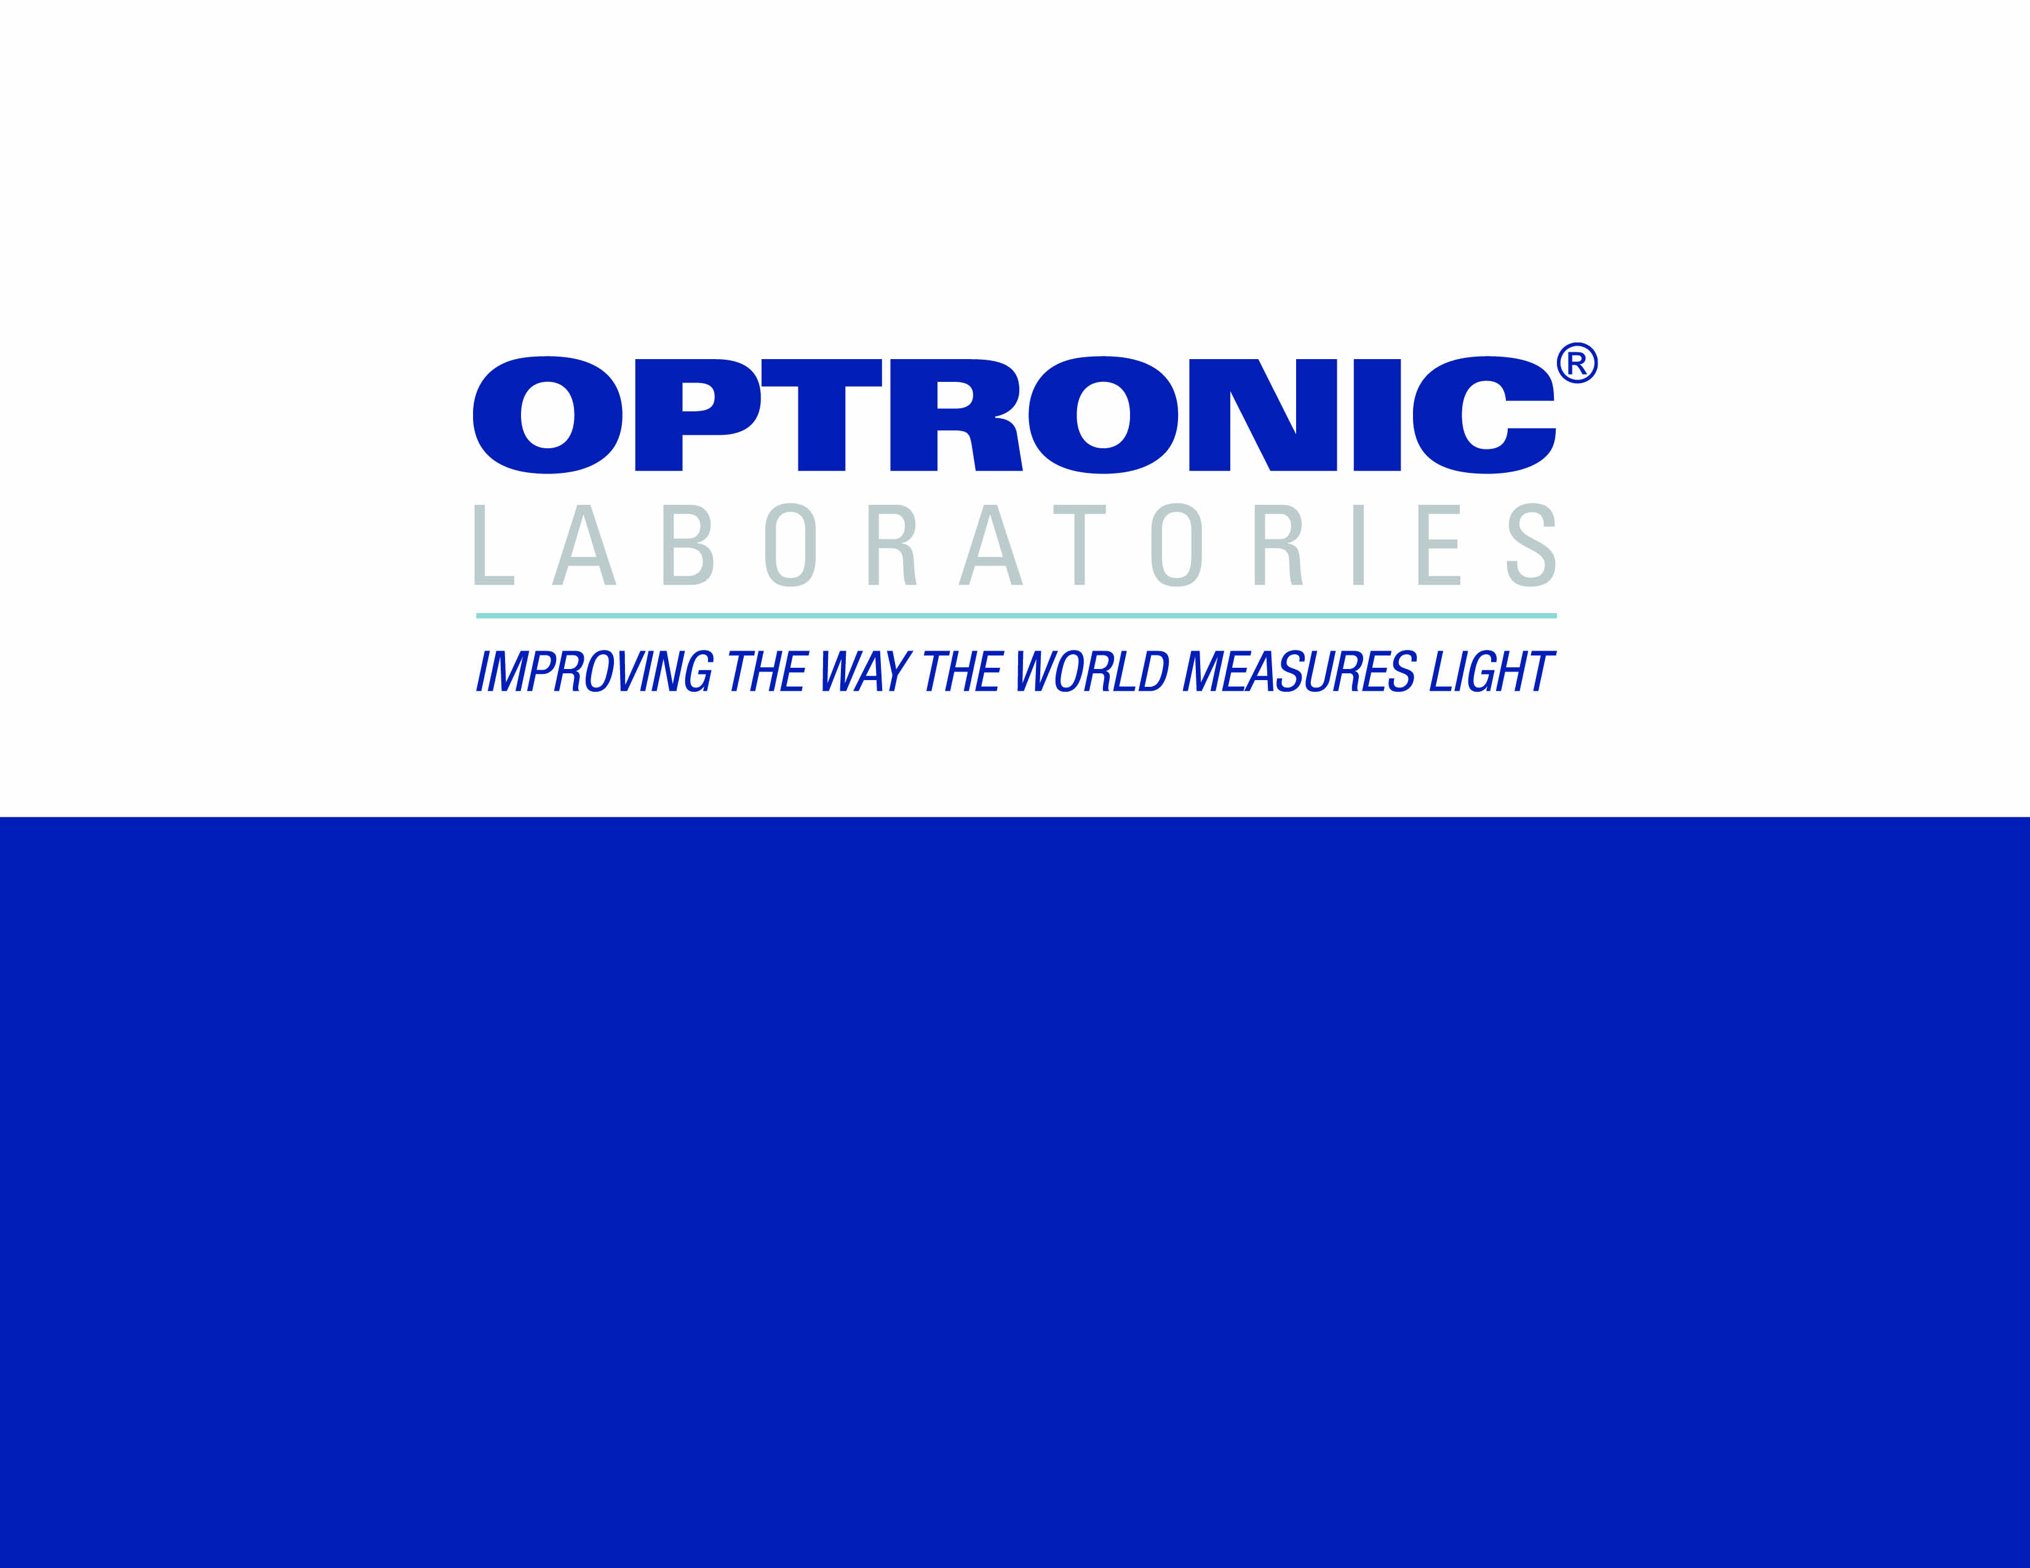
OL Series 750 Automated Spectroradiometric
Measurement System

Slide 2

ABOUT OPTRONIC LABORATORIES, LLC
• Optronic Laboratories, LLC was established in 1970 by two eminent researchers at NIST (then NBS). Facilities were modeled after NIST, and Optronic Laboratories, LLC achieved a worldwide reputation for excellence in light measurement and calibration.
• Continuing to work closely with NIST, the development of new instruments and techniques at Optronic Laboratories, LLC constantly improves the accuracy and precision of light measurement.
BACKGROUND

Slide 3
OPTRONIC LABORATORIES’ INSTRUMENTS
& SERVICES INCLUDE:
• Training, consultation & advice
BACKGROUND

Slide 4
THE HEART OF ANY SPECTRORADIOMETRIC SYSTEM IS THE MONOCHROMATOR, BUT…
• It must give the right bypass –
- Too large and spectra are distorted
- Too small and signals are low
• It must give high spectral purity (low stray light) so only the wavelength of interest is detected
THE OL SERIES 750 MONOCHROMATORS

Slide 5
• Available in single and double (shown) versions
• F/4 optics for high throughput
• Very low stray light
• Numerous special features for most accurate results
THE OL SERIES 750 MONOCHROMATORS

Slide 6
• Large range of gratings available
• Optimized for high efficiency
• Optimized for wide wavelength range
• Optimized for high resolution
THE OL SERIES 750 MONOCHROMATORS
Tri-grating mounts change gratings automatically

Slide 7
• Range of plug-in input accessories
• Choppers (shown) for IR detectors
• Automatic control of chopper speed and “open” position stop
• Filter-wheel for input attenuation or filtering
THE OL SERIES 750 MONOCHROMATORS
Versatile plug-in chopper or filter wheel input accessories

Slide 8
• Fully automated 11 position blocking-filter wheel
• Includes SHUT position for dark current readings
• Optimized filters for widest wavelength range
THE OL SERIES 750 MONOCHROMATORS
Blocking-filter wheel changes filters automatically

Slide 9
• Gratings diffract light at different angles depending on wavelength
• 400nm will also diffract at the same angle as 800nm
(since 2 x 400 = 800)
• A blocking filter removes the
400nm so just 800nm is left
THE OL SERIES 750 MONOCHROMATORS
Blocking filters:
how they work
Blocking filter
400nm + 800nm
400nm
400nm
800nm
grating

Slide 10
• Light passes into the monochromator through the entrance slit, then onto the first collimating mirror.
THE OL SERIES 750 MONOCHROMATORS

Slide 11
• Collimated (parallel) light is directed onto the grating.
THE OL SERIES 750 MONOCHROMATORS

Slide 12
• The grating diffracts the light, sending each wavelength off at a different angle.
• The desired wavelength is collected by the first focussing mirror….
THE OL SERIES 750 MONOCHROMATORS

Slide 13
• …which focuses it at the middle slit.
• A second collimating mirror collects this beam…
THE OL SERIES 750 MONOCHROMATORS

Slide 14
• …and collimates it onto a second grating.
• Since the second grating is linked to the first, they are at the same angle and hence the same wavelength.
THE OL SERIES 750 MONOCHROMATORS

Slide 15
• This second grating acts like the first, but the spectral purity is increased by many decades.
THE OL SERIES 750 MONOCHROMATORS

Slide 16
• The pure monochromatic light, at the wavelength desired, is then focussed onto the exit slit and emerges from the monochromator
THE OL SERIES 750 MONOCHROMATORS

Slide 17
• Single and double lamp versions
• UV lamp
- 200nm to 400nm
• Tungsten lamp
- 250nm to 2500nm
• Glowbar
- 1000nm to 30000nm
THE OL SERIES 740-20
LIGHT SOURCES

Slide 18
• Optics match the OL Series
750 Monochromators
• Easy switching from one source …
THE OL SERIES 740-20
LIGHT SOURCES

Slide 19
• Optics match the OL Series
750 Monochromators
• Easy switching from one source …
…TO THE OTHER
THE OL SERIES 740-20
LIGHT SOURCES
Fully automated switching available

Slide 20
• 200 to 30,000 nm coverage
• Monochromatic light prevents sample heating
• Suits a very wide range of standard OL accessories
• Suits many existing and future applications
THE OL 750 + OL 740-20

Slide 21
• In order to characterize their performance in a particular applications, single detectors, array detectors and assemblies often need spectral response to be known
• For example, photopic detectors can be analysed for V(λ) matching
DETECTOR
SPECTRAL RESPONSE

Slide 22
• Measurements are generally consistent with detector use, and may require a large collimated beam, a small spot, a diffuse source or other geometry
• Optronic Laboratories, LLC manufactures a wide range of accessories for most detector measurement requirements, including quantum efficiency
DETECTOR
SPECTRAL RESPONSE

Slide 23
• Optronic Laboratories, LLC provides standard detectors, traceable to NIST and other National Laboratories
• To illustrate a detector spectral response system, we will use the OL 750-10C All Mirror Collimator
DETECTOR
SPECTRAL RESPONSE

Slide 24
• 1 inch diameter beam
• Excellent beam uniformity
• Constant collimation at all wavelengths
THE OL 750-11C

Slide 25
• If we put these together…
THE OL 750 + OL 740-20
+ OL 750-11C

Slide 26
• We have a complete system for detector response
THE OL 750 + OL 740-20
+ OL 750-11C
Then we measure the test detector

Slide 27
• The system illustrated represents just a few of the accessories from Optronic Laboratories, LLC.
• For more information:
Visit our website at OptronicLabs.com
Call 407-422-3171 to Contact an Application Engineer
MORE INFORMATION

