Slide 1
Downloading OL 730C Parameters

Slide 2
STEPS IN
DOWNLOADING
1. Prepare a text file with the parameters you
wish to download to the OL 730C.
2. Run the program 730RS232.exe.
3. Download the file.

Slide 3
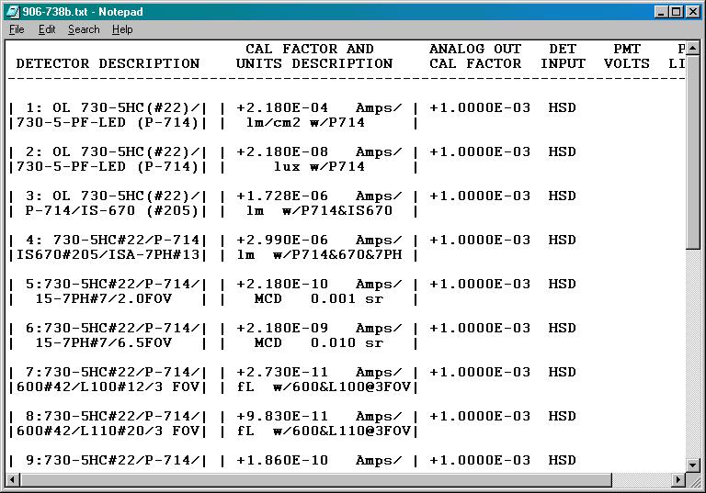
DOWNLOAD FILE
Channel number
Use Courier font to ensure bars line up and give proper spacing.

Slide 4
DOWNLOAD FILE
Description

Slide 5
DOWNLOAD FILE
Calibration Factor

Slide 6
DOWNLOAD FILE
Units

Slide 7
DOWNLOAD FILE
HSD or BNC Input

Slide 8
RUNNING
730CRS232
To download the file, you select F.
F

Slide 9
RUNNING
730CRS232
The program asks for the filename.
C:\730C\Det1.txt

Slide 10
RUNNING
730CRS232
Entry field shows downloading is complete.

Slide 11
RUNNING
730CRS232
To exit the program, you select Q.
Q

Slide 12
• For more information: Visit our website at OptronicLabs.com Call 407-422-3171 to Contact an Application Engineer
MORE INFORMATION

