Slide 1
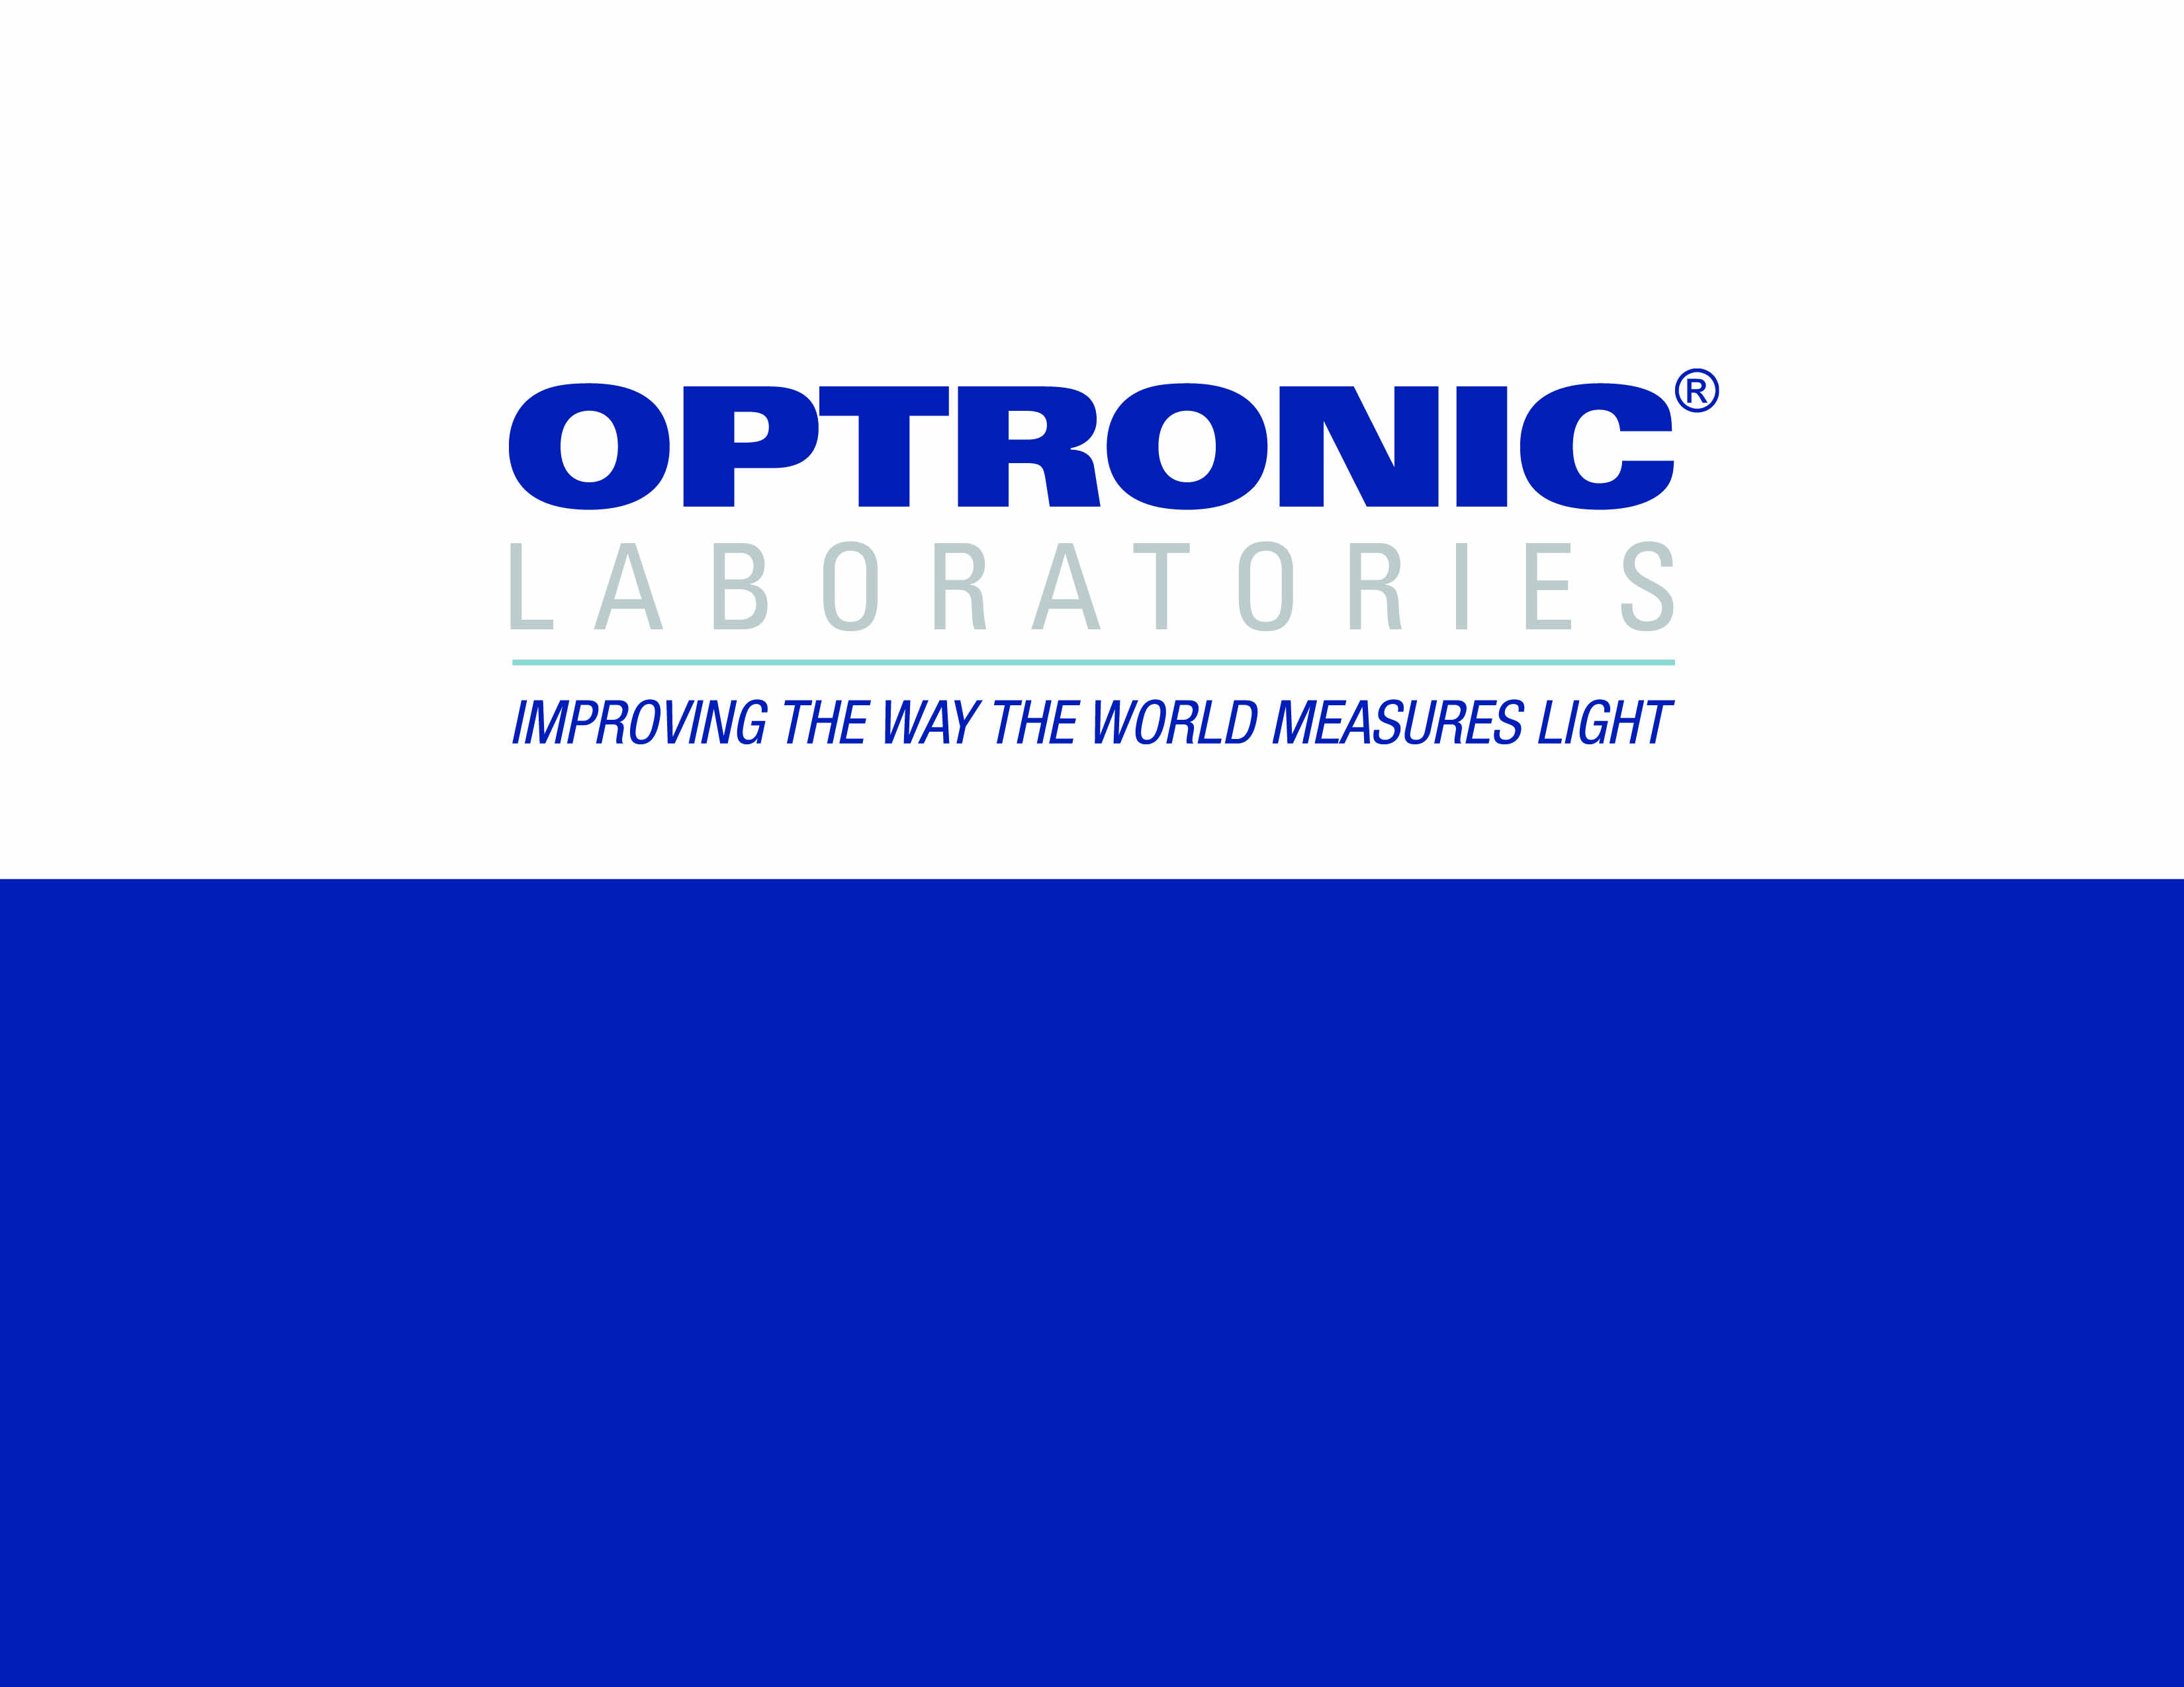
OL 750 Diffuse Spectral
Reflectance Measurement System

Slide 2

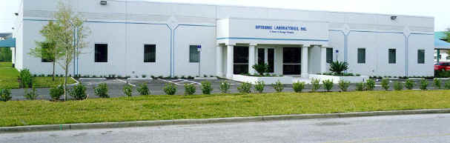
ABOUT OPTRONIC LABORATORIES, LLC
• In 1998, Optronic Laboratories, LLC moved into its new 25,000 square foot purpose-built facility, consolidating and expanding production, R & D and calibration facilities.
BACKGROUND

Slide 3
THE HEART OF ANY SPECTRORADIOMETRIC SYSTEM IS THE MONOCHROMATOR, BUT…
• It must give the right bypass –
- Too large and spectra are distorted
- Too small and signals are low
• It must give high spectral purity (low stray light) so only the wavelength of interest is detected
THE OL SERIES 750 MONOCHROMATORS

Slide 4
• Available in single and double (shown) versions
• F/4 optics for high throughput
• Very low stray light
• Numerous special features for most accurate results
THE OL SERIES 750 MONOCHROMATORS

Slide 5
• Large range of gratings available
• Optimized for high efficiency
• Optimized for wide wavelength range
• Optimized for high resolution
THE OL SERIES 750 MONOCHROMATORS
Tri-grating mounts change gratings automatically

Slide 6
• Range of plug-in input accessories
• Choppers (shown) for IR detectors
• Automatic control of chopper speed and “open” position stop
• Filter-wheel for input attenuation or filtering
THE OL SERIES 750 MONOCHROMATORS
Versatile plug-in chopper or filter wheel input accessories

Slide 7
• Fully automated 11 position blocking-filter wheel
• Includes SHUT position for dark current readings
• Optimized filters for widest wavelength range
THE OL SERIES 750 MONOCHROMATORS
Blocking-filter wheel changes filters automatically

Slide 8
• Gratings diffract light at different angles depending on wavelength
• 400nm will also diffract at the same angle as 800nm
(since 2 x 400 = 800)
• A blocking filter removes the
400nm so just 800nm is left
THE OL SERIES 750 MONOCHROMATORS
Blocking filters:
how they work
Blocking filter
400nm + 800nm
400nm
400nm
800nm
grating

Slide 9
• Light passes into the monochromator through the entrance slit, then onto the first collimating mirror.
THE OL SERIES 750 MONOCHROMATORS

Slide 10
• Collimated (parallel) light is directed onto the grating.
THE OL SERIES 750 MONOCHROMATORS

Slide 11
• The grating diffracts the light, sending each wavelength off at a different angle.
• The desired wavelength is collected by the first focussing mirror….
THE OL SERIES 750 MONOCHROMATORS

Slide 12
• …which focuses it at the middle slit.
• A second collimating mirror collects this beam…
THE OL SERIES 750 MONOCHROMATORS

Slide 13
• …and collimates it onto a second grating.
• Since the second grating is linked to the first, they are at the same angle and hence the same wavelength.
THE OL SERIES 750 MONOCHROMATORS

Slide 14
• This second grating acts like the first, but the spectral purity is increased by many decades.
THE OL SERIES 750 MONOCHROMATORS

Slide 15
• The pure monochromatic light, at the wavelength desired, is then focussed onto the exit slit and emerges from the monochromator
THE OL SERIES 750 MONOCHROMATORS

Slide 16
• For transmission, reflection and detector response measurements, a light source at the entrance of the
OL 750 creates monochromatic light at the exit.
• The OL Series 740-20 is an ideal light source for most applications.
OL SERIES 740-20
LIGHT SOURCES

Slide 17
• Single and double lamp versions
• UV lamp
- 200nm to 400nm
• Tungsten lamp
- 250nm to 2500nm
• Glowbar
- 1000nm to 30000nm
THE OL SERIES 740-20
LIGHT SOURCES

Slide 18
• Optics match the OL Series
750 Monochromators
• Easy switching from one source …
THE OL SERIES 740-20
LIGHT SOURCES

Slide 19
• Optics match the OL Series
750 Monochromators
• Easy switching from one source …
…TO THE OTHER
THE OL SERIES 740-20
LIGHT SOURCES
Fully automated switching available

Slide 20
• 200 to 30,000 nm coverage
• Monochromatic light prevents sample heating
• Suits a very wide range of standard OL accessories
• Suits many existing and future applications
THE OL 750 + OL 740-20

Slide 21
• Reflectance can be specular (like a mirror) or diffuse
(like paper)
• Optronic Laboratories, Inc. manufacture a wide range of accessories for regular and diffuse transmittance
REFLECTANCE
MEASUREMENT

Slide 22
• Optronic Laboratories, Inc. manufacture a range of fixed-angle and Edward Spheres for diffuse reflectance measurements.
• To illustrate a diffuse reflectance measurement system, we will use the OL 750-70 Diffuse Reflectance Attachment.
DIFFUSE
REFLECTANCE

Slide 23
• Diffuse reflectance is measured against a standard
• A scan is run with the standard, then another with the sample
DIFFUSE
REFLECTANCE
Sample

Slide 24
• From a simple viewpoint, the ratio of these scans would indicate the sample reflectance
• However, the throughput of the sphere changes due to the sample
DIFFUSE
REFLECTANCE
CAUTION:
Change in throughput
DO NOT USE
Sample

Slide 25
• Instead, the double beam method should be used
• This involves 4 scans, 3 to calibrate and one to measure
DIFFUSE
REFLECTANCE
Scan 4
Scan 3
Sample

Slide 26
• The scans with the beam directed at the wall of the sphere correct for the throughput changes
• The true reflectance can then be calculated
DIFFUSE
REFLECTANCE
Scan 4
Sample

Slide 27
• Uses the double beam method for accurate values of reflectance
• Software guides the user through the calibration and measurement
THE OL SERIES
750-70
Beam switch mirror
Standard or sample

Slide 28
  • 2 versions of the OL 750-70 are available
  - PTFE sphere coating for
  250nm to 2,500nm
  - Gold sphere coating for
  1,000nm to 30,000nm
THE OL SERIES
750-70
Standard or sample

Slide 29
• If we put these together…
THE OL 750 + OL 740-20
+ OL 750-70
And add a detector
Positive location
&
Easy assembly

Slide 30
• We have a complete system for diffuse reflectance
THE OL 750 + OL 740-20
+ OL 750-70
The light-trap supplied also allows measurements which exclude specular reflections

Slide 31
• The system illustrated represents just a few of the accessories from Optronic Laboratories, LLC
• For more information:
Visit our website at OptronicLabs.com
Call 407-422-3171 to Contact an Application Engineer
MORE INFORMATION

