Slide 1

Latest Advances in
Spectroradiometric Measurement Systems for Night Vision Compatible Displays

Slide 2

OUTLINE OF PRESENTATION
• About Optronic Laboratories, LLC
• Introduction to the OL 750-NVG
• Practical aspects of Measurement
• Key MIL-L-85762A Requirements and OL 750-NVG Performance
• Essential Performance Beyond MIL-L-85762A
• Special Features

Slide 3
ABOUT OPTRONIC LABORATORIES, INC.
• Optronic Laboratories, LLC was established in 1970 by two eminent researchers at NIST (then NBS). Facilities were modeled after NIST, and Optronic Laboratories, LLC. achieved a worldwide reputation for excellence in light measurement and calibration.
• Continuing to work closely with NIST, the development of new instruments and techniques at Optronic Laboratories, LLC constantly improves the accuracy and precision of light measurement.
BACKGROUND

Slide 4
OPTRONIC LABORATORIES’ INSTRUMENTS
& SERVICES INCLUDE:
• Training, consultation & advice
BACKGROUND

Slide 5
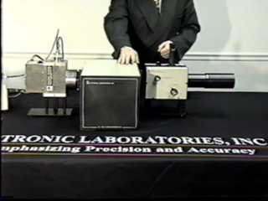
INTRODUCTION TO
THE OL 750-NVG
The OL 750-NVG measures NVIS compatible displays to
MIL-L-85762A with unequaled accuracy and performance

Slide 6
INTRODUCTION TO
THE OL 750-NVG
Powerful software with dedicated NVIS routines
A specially configured
OL 750 monochromator
Digital Signal Processing (DSP) for best results
Temperature regulation for stability
A special high-sensitivity
low-noise GaAs PMT
The OL 600-NVG Telescope

Slide 7
INTRODUCTION TO
THE OL 750-NVG
The OL 750-NVG comprises:
Now for a closer look at the special OL 750 monochromator configuration:
Specifically for NVIS measurements

Slide 8
INTRODUCTION TO
THE OL 750-NVG
The OL 750-NVG comprises:
Blocking filters optimized for lowest stray light
Fully automatic ND filter wheel for highest dynamic range
Choice of single
or double monochromator
Depolarizer for accurate results even on LCD displays
Multiple gratings for optimum response

Slide 9
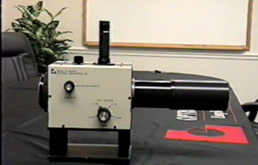
INTRODUCTION TO
THE OL 600-NVG
The OL 600-NVG is ideal for display measurements because it uses a “Pritchard” design. The parallax and alignment errors of other designs are eliminated completely.
Here is how it works

Slide 10
INTRODUCTION TO
THE OL 600-NVG
Image appears with a “missing” circular area
The “missing” portion is sent to the detector
Display

Slide 11
INTRODUCTION TO
THE OL 600-NVG
Diffraction- limited optics
• Diffraction-limited optics ensure the sharpest, clearest images are seen
• Multiple apertures for optimum field-of-view
• Photometer option available
Eyepiece is actually a
high quality microscope
for best viewing
Measurement area can be sent to OL 750-NVG or photometer without re-alignment

Slide 12
INTRODUCTION TO
THE OL 600-NVG
• Diffraction-limited optics ensure the sharpest, clearest images are seen
• Multiple apertures for optimum field-of-view
• Photometer option available
Diffraction- limited optics
Eyepiece is actually a
high quality microscope
for best viewing
Measurement area can be sent to OL 750-NVG or photometer without re-alignment

Slide 13
PRACTICAL ASPECTS
OF MEASUREMENT
• The first stage in testing is to isolate the part of the display to be measured.
• This is a lot easier if the user sees a magnified image of the display.

Slide 14
PRACTICAL ASPECTS
OF MEASUREMENT
Anything within the black circle is measured
• This black circle is no more than the image of an aperture, which can be changed to suit measurements.

Slide 15
PRACTICAL ASPECTS
OF MEASUREMENT
3.00 mm
(0.12”)
• The OL 600-NVG has 5 selectable apertures to provide
the optimum spot sizes for all NVIS displays. These are:

Slide 16
• MIL-L-85762A specifies performance of NVIS compatible displays, but the equipment used in testing conformance must also meet specifications.
• Testing equipment must meet ALL of the specifications.
• Some of these specifications are trivial for modern instruments, but others require special innovations to give conformance.
MIL-L-85762A
REQUIREMENTS

Slide 17
• Testing of NVIS compatible displays to MIL-L-85762A is an absolute requirement for the USA and is generally adopted worldwide. Testing equipment is specified in Appendix B.
MIL-L-85762A
REQUIREMENTS
APPENDIX B
SPECTRAL RADIANCE, LUMINANCE, AND ILLUMINANCE MEASURING EQUIPMENT
B10. SCOPE
B10.1 Scope. This appendix details the requirements of the chromaticity, spectral radiance, luminance, and illuminance measurement equipment to be used when performing measurements in accordance with this specification. This Appendix is a mandatory part of this specification. The information contained herein is intended for compliance.

Slide 18
• MIL-L-85762A Appendix B covers the requirements of the testing system and calculations
• Appendix B40 covers Photopic testing equipment
• Appendix B30 covers spectroradiometric testing equipment
MIL-L-85762A
REQUIREMENTS
The OL 750-NVG passes
ALL requirements
of B30 and B40

Slide 19
• To demonstrate conformance, the following slides will show key individual requirements with actual
OL 750-NVG performance.
MIL-L-85762A
REQUIREMENTS

Slide 20
• A spectroradiometer must be used for chromaticity and spectral radiance measurements
MIL-L-85762A
REQUIREMENTS
B30. SPECTRORADIOMETER
B30.1 Chromaticity and spectral radiance measurement equipment. Chromaticity and spectral radiance measurements shall be made using a spectroradiometer meeting the requirements herein. The following calibrations and checks shall be performed within the time period specified in order to assure that the spectroradiometer meets the requirements of this specification. Records of how the spectroradiometer calibration was performed, when performed and the standard lamp used shall be maintained by the contractor and shall be available for government inspection.

Slide 21
MIL-L-85762A
REQUIREMENTS
MIL-L-85762A SPECIFICATION
B30.2 Spectroradiometer sensitivity.
Wavelength Radiance level
380 to 600 nm 1.0 x 10⁻¹⁰ W/cm² sr nm
600 to 900 nm 1.7 x 10⁻¹¹ W/cm² sr nm
900 to 930 nm 1.0 x 10⁻¹⁰ W/cm² sr nm
B30.2.1 Spectroradiometer sensitivity calibration shall be performed within six months (or more frequently if required to insure the spectroradiometer meets the requirements specified herein) prior to taking a measurement. This calibration shall be traceable to NBS standards. The calibrations shall be performed over the wavelength band and at intervals consistent with the measurements to be made. The calibration shall demonstrate that the spectroradiometer meets the sensitivity requirements of B30.2. A separate calibration must be performed for each set of optics used, or when filters are used in front of the spectroradiometer.

Slide 22
MIL-L-85762A
REQUIREMENTS
B30.6 Linearity.
Within any given measurement scale, the linearity shall be ±1% of the full scale value. The linearity between any two measurement scales shall be ± 2%.
B30.6.1 Linearity verification
The linearity of the spectroradiometer shall be verified within 6 months prior to taking a measurement. A linearity check shall be performed on each detector used during the test procedures. The spectroradiometer operational parameters shall not be varied during the linearity test. The linearity check shall be performed at a specific wavelength (to be determined by the contractor) which shall not be varied during the linearity test. A light source which can be precisely, mechanically or optically varied in intensity shall be used for the linearity check. Acceptable methods that may be used to vary the intensity of the light source include the use of neutral density filters (with known transmission), precision apertures, superposition, or the inverse square law (provided the distance between the lamp and spectroradiometer can be precisely controlled using a photometric type bench). Dimming of the lamp through electronic means is unacceptable. The intensity of the lamp shall be adjusted to give a full scale reading on the lowest level of dynamic range of the spectroradiometer. Call the lamp output N and the reading on the spectroradiometer R. The intensity of the lamp shall be varied in accordance with the table below, and, in order to pass the linearity check the output of the spectroradiometer, over its entire dynamic range (as applicable) shall be within the limits shown below.
Lamp Output Spectroradiometer Output Lamp Output Spectroradiometer Output
0.1N 0.1R ± .01R 100 N 100 R ± 2.0 R
0.5 N 0.5 R ± .01 R 500 N 500 R ± 20 R
5 N 5.0 R ± 0.2 R 1000 N 1000 R ± 20 R
10 N 10 R ± 0.2 R 5000 N 5000 R ± 200 R
50 N 50 R ± 2.0 R 10000 N 10000 R ± 200 R

Slide 23
MIL-L-85762A
REQUIREMENTS
The viewing system is specified in many sections of
MIL-L-85762A Appendix B, and essentially describes the performance of the telescope used to align devices prior to measurements. To summarize:
B30.9 and B40.2.1 and B40.4 Measurement of a 0.007" spot is available.
B30.10 Max. View/Measure alignment error of 5%.
B40.5 Max. View/Measure alignment error of 0.002".
B40.4 Minimum focal distance of 4".
The OL 600-NVG
telescope meets
ALL of these specifications

Slide 24
MIL-L-85762A
REQUIREMENTS
B40.1 Luminance measurement equipment.
Luminance measurements can be made using either a spectroradiometer meeting the requirements of B30 through B30.11.1 above or a photometer meeting the requirement herein. When a photometer is used as part of the test equipment, the following calibrations and checks shall be verified within a year prior to taking a measurement in order to assure that the photometer meets the requirements of this specification. Records of calibrations and checks shall be maintained by the contractor and shall be available for government inspection.
Measure both ways
with ONE system
OL 750-NVG
spectroradiometer
OL 600-NVG-P
photometer

Slide 25
MIL-L-85762A
REQUIREMENTS
B40.6 Photometer polarization error.
The polarization error shall be no greater than 1%
NOTE
This specification is actually in the wrong section. Photometers rarely show polarization errors, but spectroradiometers are generally highly sensitive to polarization. Proper luminance (and radiance) measurements with spectroradiometers can only be done if de-polarization optics are added.
Measure LCD and AMLCD
Displays without error
OL 750-NVG
spectroradiometer
OL 600-NVG-P
photometer

Slide 26
BEYOND
MIL-L-85762A
Dynamic range
The brightest intensity measurable divided by the lowest (without changing the conditions of testing).

Slide 27
BEYOND
MIL-L-85762A
There is no specification for dynamic range, but….MIL-L-85762A implies that the sensitivity specification applies at all luminances
PMTs have very limited dynamic range so most systems must ignore
MIL-L-85762A sensitivity specifications when testing sources brighter than 1 fL

Slide 28
BEYOND
MIL-L-85762A
The OL 750-NVG
features 10 decades
of dynamic range
for each measurement,
so bright sources can be measured while meeting
MIL-L-85762A sensitivity specifications.

Slide 29
• There are no high or low scan speed limitations specified, but faster is preferred.
• The OL 750-NVG can give quality NVIS results in 2 minutes or less.
MIL-L-85762A
REQUIREMENTS

Slide 30
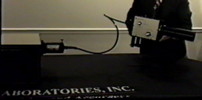
• Sometimes, when testing cockpit displays, you need to climb into a cockpit
SPECIAL FEATURES
The supplied baffle-tube is ideal for quick focus and low stray light, just place the end against the cockpit display
With a fiber-optic cable, you can make measurements anywhere with the OL 750-NVG
Remove the OL 600-NVG base to reveal a tripod mounting thread

Slide 31
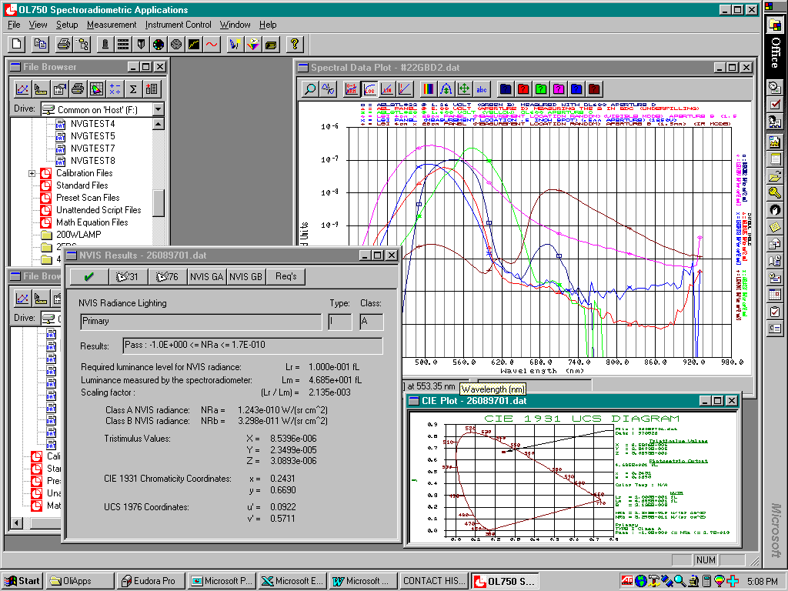
SPECIAL FEATURES
Multiple browsers for easy storage & retrieval
Multi-Spectral
plots
CIE
Plots
&
reports
MIL-spec & custom Pass/Fail

Slide 32
• Scan wizard makes calibrations and measurements easy for any user
• Calculations according to MIL-L-85762A
• Users can add customer/vendor specifications
• NVIS conformance reports with choice of layout
SPECIAL FEATURES

Slide 33
• Many other useful built-in color calculations: LAB/LUV, CRI etc
• Powerful Macro facility for user manipulations using equation editor
• Radiometer/photometer software is built-in to OL 750 spectroradiometer software – no switching programs
SPECIAL FEATURES
The list of special features goes on
and on…

Slide 34
• The features illustrated represent just a few of the main benefits of the OL 750-NVG system
• For more information:
Visit our website at OptronicLabs.com
Call 407-422-3171 to Contact an Application Engineer
MORE INFORMATION

