Slide 1
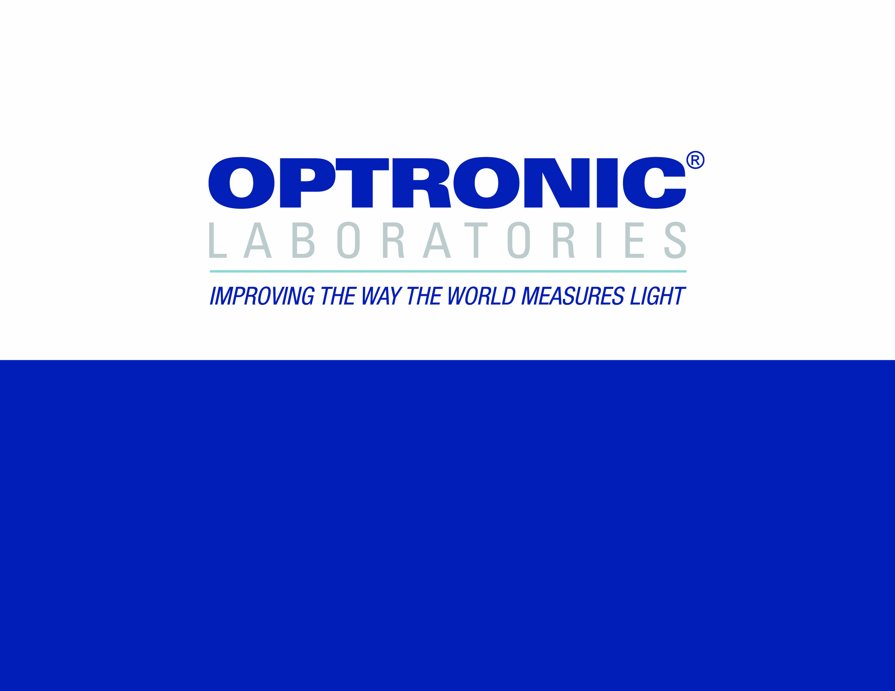
POLARIZATION:
THE INVISIBLE PROPERTY OF LIGHT
Notes:
Human sight is not sensitive the polarization state of light. In many ways describing polarization is therefore like describing a sunset to a blind person.

Slide 2
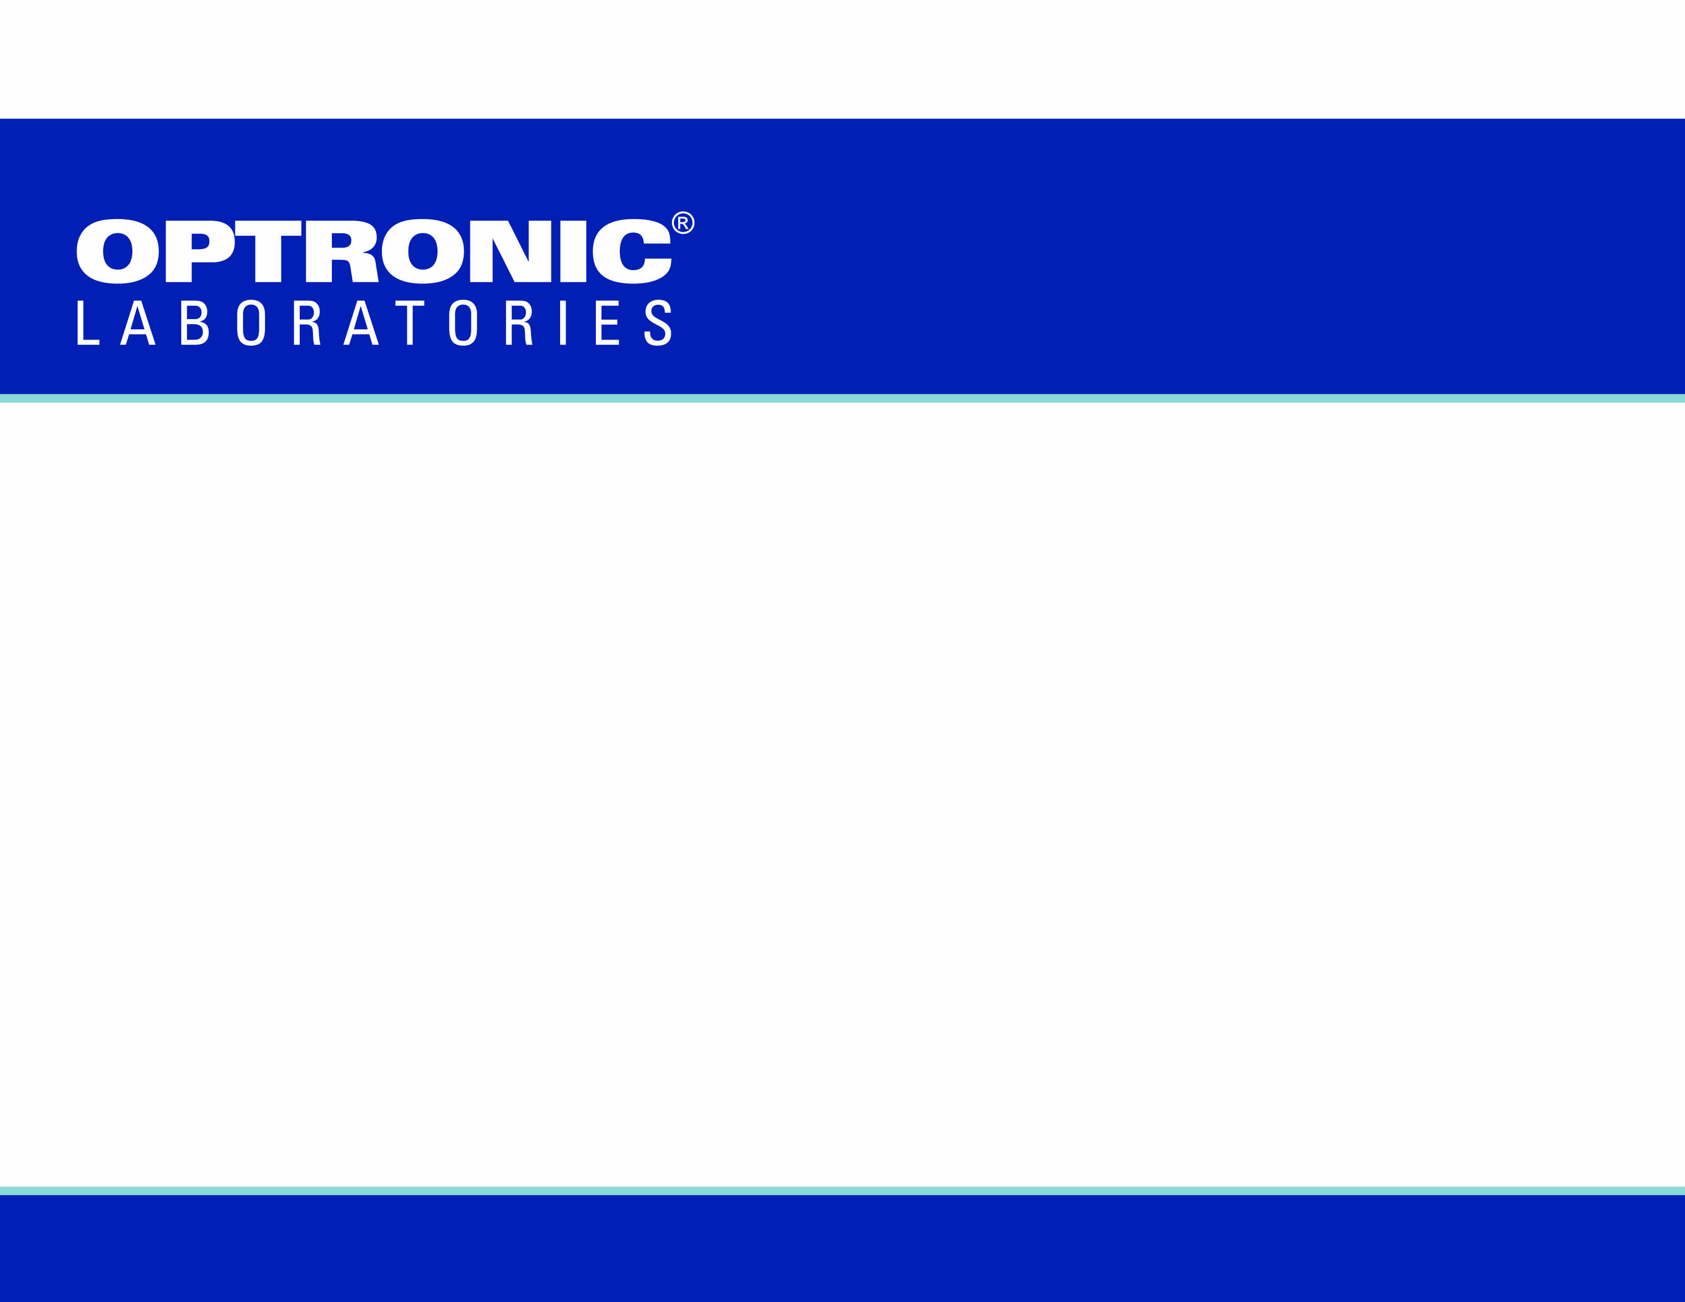
A.4.6 PHOTOMETER POLARIZATION ERROR
• The polarization error shall be no greater than 1%.
A.4.6.1 PHOTOMETER POLARIZATION ERROR VERIFICATION
• The polarization error shall be checked by placing a linear polarizer in the optical path between the standard lamp and the photometer and then measuring the luminance. The polarizer shall be rotated 45° and another measurement shall be made. The polarizer shall be rotated another 45° and another measurement shall be made. The photometer shall be considered as having passed the polarization error test if the difference between the three measurements is lower than or equal to the percent error specified in A.4.6. Throughout the test the alignment of the standard lamp shall not be changed. The transmission of the linear polarizer shall be greater than or equal to 20%, and the transmission of two pieces of the polarizer material, when oriented so that the direction of polarization of the two pieces are at right angles, shall be less than or equal to 0.1%.
MIL-STD-3009 (MIL-L-85762A)
Notes:
In cockpit lighting applications, the source may be polarized e.g. AMLCD displays. The pilot does not see this polarization but any instrument used to measure the color or luminance can be affected. To ensure the instrument is suitable, MIL-L-85762A and MIL-STD-3009 recommend a specific test for luminance polarization error. Photometers failing this test cannot be used for luminance measurements.

Slide 3
the weather was thick and stormy . . .
The king looked about and saw no blue sky . . . then the king took the sunstone* and held it up, and then he saw where [the Sun] beamed from the stone
• Hrafns Saga (possibly composed by priest Tómas Þórarinsson from
Selárdalr d.1253).
* Probably crystal cordierite, common in Norway
THE VIKINGS
Notes:
A bit of history: Polarization was possibly used as an aid to navigation by the Vikings around 1000 years ago. This predates the use of the compass in the western world!

Slide 4
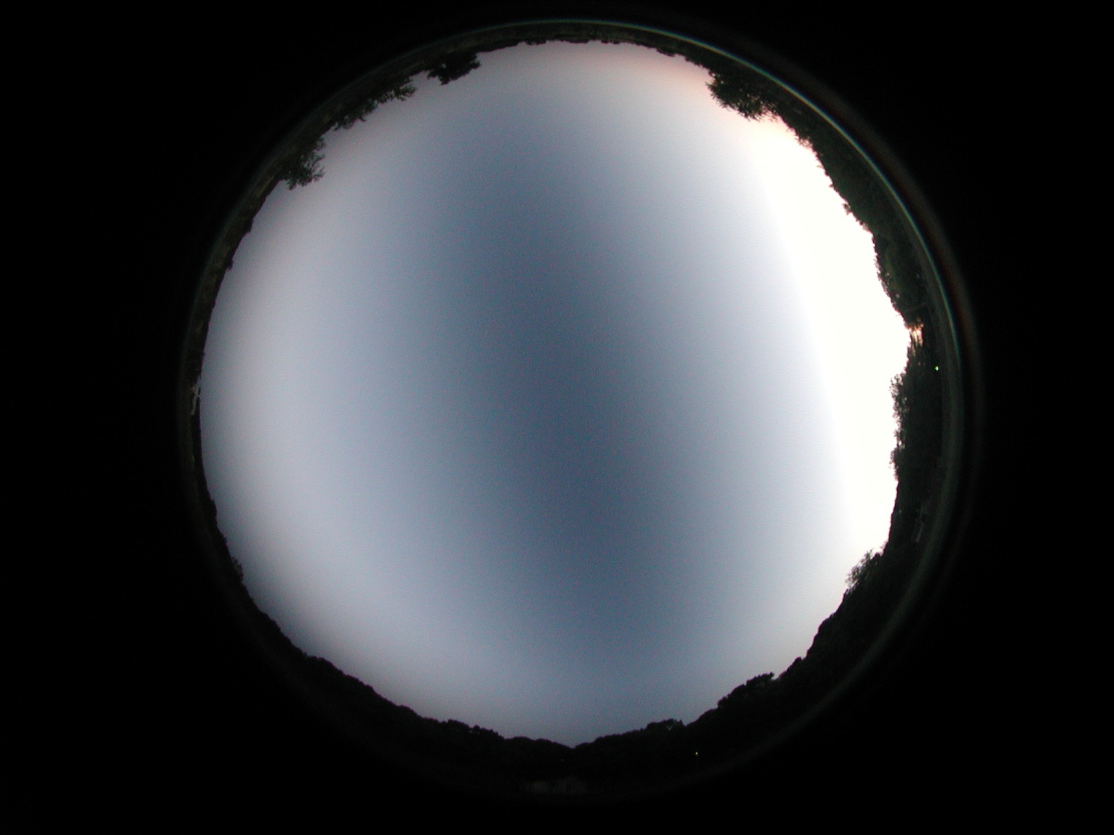
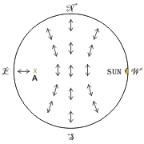
SKY AT SUNSET VIA A POLARIZING FILTER
- Kindly provided by Forrest Mims,
South-Central Texas Observatory
SKY POLARIZATION
Notes:
When the sun is low in the sky, any portion of clear sky can be used to indicate the sun’s position because the scattered blue light is polarized.
The scientific study of polarization did not begin until the late 17th. Century however. Even then, eminent scientists like Newton opposed several correct theories because he though light could not be both a particle and a wave. Not until Thomas Young’s famous double slit interference experiment in 1801 was the wave nature of light proved.

Slide 5


GLARE FROM WATER
Notes:
Polarization occurs widely in nature. For instance, glare from the surface of water makes it difficult to see what is beneath. A polarizing film held in one orientation seems to have no effect whereas the glare is reduced or completely eliminated if the film is rotated 90°.

Slide 6
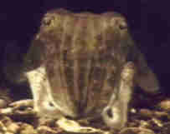
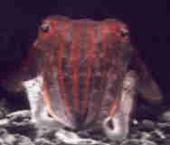
A CUTTLEFISH
AQUATIC LIFE
• Normal View
• False color
Red = horizontal,
Blue = vertical polarization
Notes:
If reflections from the water surface are affected by the polarizer the light must be polarized. If the reflection is polarized then so must the transmission. It is not surprising to discover therefore that some aquatic animals have evolved to see and use polarization. A cuttlefish is known for its ability to change the color of its skin, but a less known fact is it can change the light polarization. The false color image composite on the right shows the cuttlefish’s reflectivity under polarized light.

Slide 7
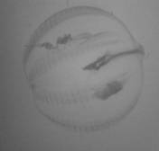
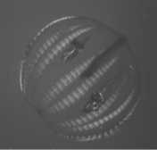
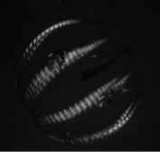
CTENOPHORE PLANKTON
AQUATIC LIFE
Unpolarized Light
• Combined Image
Crossed Polarizers
Notes:
Polarization can also help to see and identify prey. Ctenophore plankton is almost complete transparent in unpolarized light but when placed between crossed polarizers stands out against the background. A mixture of these images, equivalent to the partial polarization conditions under water, gives optimum images for recognition.

Slide 8
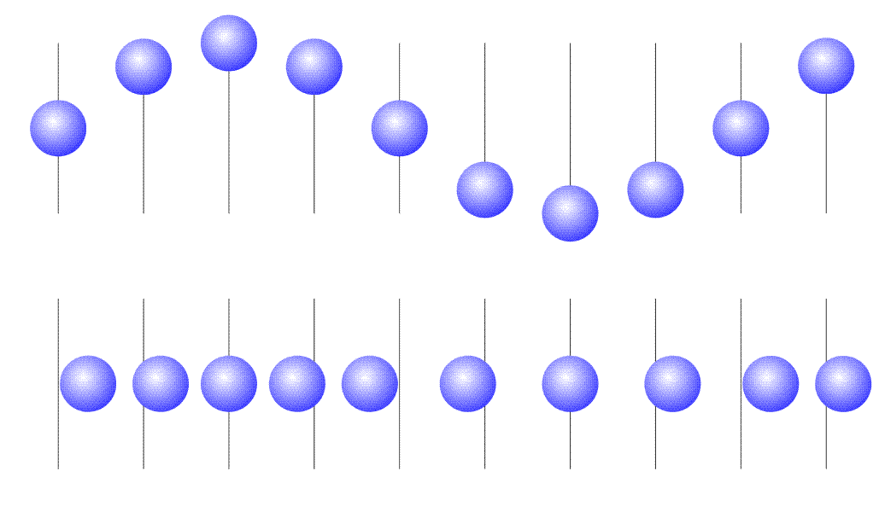
LIGHT IS A WAVE
Transverse Wave
Longitudinal Wave
Direction of travel
Notes:
So what is polarization? We know the light behaves like a wave, but what type? There are two basic types of wave, transverse and longitudinal. Longitudinal waves occur in the same direction as the travel and include examples such as sound moving through air, sonar and other compression waves. Transverse waves occur at right angles to the direction of travel and include examples such as ripples across the surface of water or plucking a guitar string. Longitudinal waves cannot be polarized but transverse waves vibrate in a plane. There are an infinite number of planes around the directions of travel and if the light is a random mix of planes it is called unpolarized. If all the light vibrates in the same plane it is linearly polarized, and the line is the orientation of the plane (or more precisely the orientation of electric vector of the light).

Slide 9
POLARIZERS
Notes:
So what is polarization? We know the light behaves like a wave, but what type? There are two basic types of wave, transverse and longitudinal. Longitudinal waves occur in the same direction as the travel and include examples such as sound moving through air, sonar and other compression waves. Transverse waves occur at right angles to the direction of travel and include examples such as ripples across the surface of water or plucking a guitar string. Longitudinal waves cannot be polarized but transverse waves vibrate in a plane. There are an infinite number of planes around the directions of travel and if the light is a random mix of planes it is called unpolarized. If all the light vibrates in the same plane it is linearly polarized, and the line is the orientation of the plane (or more precisely the orientation of electric vector of the light).

Slide 10
POLARIZER “RULE”
1. A polarizer will transmit 50% of an unpolarized light beam. This applies to ALL orientations.
2. If a second polarizer is aligned in the same orientation as the first, it has no effect.
I₀
½I₀
½I₀
Notes:
Several rules can be use for perfect polarizers to describe the behavior of polarizer combinations.
If unpolarized light passes through a polarizer, 50% of the light will be transmitted (ignoring absorption). This is true for all orientations of the polarizer. Light emerging will be linearly polarized according to the orientation of the polarizer.
A second polarizer of the same orientation will transmit all the light.

Slide 11
POLARIZER “RULE”
3. Malus’ Law: if the angle between two polarizers is θ, then the effect of the combination (ignoring absorption) is cos²(θ)
cos²(45˚) = ½
I₀
½I₀
I₀
½I₀
½I₀
¼I₀
Notes:
3. As the angle between the orientations of the two polarizers are increased, the intensity transmitted decreases. It varies with the square of the cosine of the angle. This is called Malus’ law.

Slide 12
POLARIZER “RULE”
4. The order of the polarizers doesn’t matter if only two are used.
I₀
½I₀
¼I₀
Notes:
4. The transmittance depends only on the angle between the polarizer orientations. The order of the polarizers doesn’t matter.

Slide 13
POLARIZER “RULE”
5. Crossed polarizers (at 90˚) transmit no light
cos²(90˚) = 0
I₀
½I₀
No light
Notes:
5. In accordance with Malus’ law crossed polarizers, that is polarizers with orientations at 90˚ to each other, transmit no light (cos²(90˚)=0)

Slide 14
POLARIZER “RULE”
6. The order matters if 3 or more polarizers are used.
I₀
½I₀
No light
No light
Notes:
6. The order does matter if 3 or more polarizers are in series. For example, if a third polarizer is added after the cross polarizers at 45˚ to them both, none of the original unpolarized light gets through. Since polarizers do not create light this must be true.

Slide 15
POLARIZER “RULE”
6. The order matters if 3 or more polarizers are used.
I₀
½I₀
¼I₀
⅛I₀
It is clear from this that polarizers do not simply absorb light.
Notes:
However, move the 45˚ polarizer between the crossed polarizers and now light is transmitted. It is clear from this that polarizers do not simply absorb light.
Imagine the polarizer as a picket fence and the light wave as a wave in a rope extending through a gap in the fence. As the rope is moved up and down the wave gets through the fence because vertically the gap is large. Moving the rope left to right creates waves that would be blocked by the fence because horizontally the gap is small. If the direction of the wave is not quite vertical, contacts with the sides of the gap would tend to nudge the wave slightly and hence rotate the wave. Naturally, this analogy can only be taken so far but it is a useful visualization tool.

Slide 16
LIQUID CRYSTALS
Liquid crystals in displays use this principle to transmit maximum light when “on”.
The alignment of the polarizer “stack” changes with voltage.
Notes:
Extending this principle to a large number of polarizers, it is possible to incrementally rotate the polarization plane so as transmit between end cross-polarizers. This makes the transmittance very dependent on the polarizer orientations and any disruption in the incremental rotations would affect observed intensity. LCD displays use this principle, controlling the alignments with applied voltage.

Slide 17
Notes:
The more polarizers that can be incrementally arranged between the end crossed polarizers, the higher the transmittance. By aligning the two surface molecules at 90°, the natural tendency of liquid crystal molecules to align with its neighbors will result in thousands of incremental orientations, making the transmittance very efficient. The applied voltage then disrupts the alignment, reducing transmittance.

Slide 18
POLARIZATION
BY REFLECTION
Fresnel Equations:
Notes:
Polarization can also result from reflection. This is the glare from water shown earlier. Fresnel described the reflection for two polarizations. The incident, reflected and refracted rays are all within a plane, called the p-plane. Reflection of polarized light in the p-plane is described by the top equation. At 90° to the p-plane is the s-plane and the bottom equation describes reflection of s-polarized light.

Slide 19
POLARIZATION
BY REFLECTION
Notes:
At most angles the two polarizations have different reflectivities. In fact, the p-polarized light decreases to zero reflectance at one angle, known as the Brewster angle. At this angle reflected light must be entirely s-polarized. Of course transmittance is partially polarized since there is now more p-polarized than s-polarized light. A stack of many parallel plates, where this effect is repeated at each surface, results in the transmitted beam being essentially p-polarized and the reflection being entirely s-polarized.

Slide 20
CHIRALITY
(OPTICAL ISOMERS)
Tartaric Acid Crystals
Each rotates the plane of polarized light in different directions
Notes:
Light can interact with materials in many different ways, and polarization adds a new dimension to those interactions. For instance, some molecules rotate the plane of rotation. These molecules lack symmetry apart from mirror images and hence come in left-hand and right-hand opposites. The rotation seen depends on both the strength of the rotational effect and the path length of light. This property is commonly used in the pharmaceutical industry to distinguish the two forms. This is because biological enzymes only work on one form and the other is unreactive. In fact L-amino acids are used exclusively to build proteins by all life on earth.
Molecules that have the same formula but different arrangements are called isomers. These particular isomers are so similar they can only be distinguished using polarized light and hence are called optical isomers (or enantiomers).

Slide 21

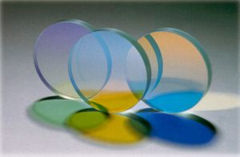
DICHROISM
Polarization-dependent absorption (generally highly wavelength dependent so colors can be separated).
Notes:
If absorption within a material is polarization dependent it is dichroic. A polarizer is therefore dichroic but normally the term is reserved for materials that have highly wavelength dependent dichroism since separation of colors is the primary application of this effect.

Slide 22
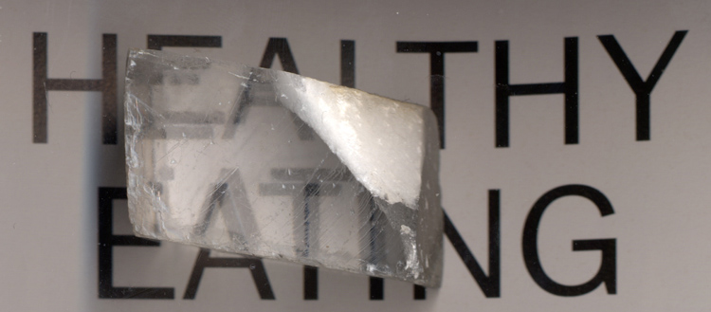
Polarization-dependent refraction. One slow and one fast ray means they take different paths through the material, e.g. calcite
BIREFRINGENCE
(DOUBLE REFRACTION)
Notes:
Some materials refract polarized light in different ways. Instead of having just one index of refraction these substances have two, depending on the polarization through the crystal. This means that the different polarizations follow two distinct paths through the material, hence it is called double refraction or birefringence. A common example is calcite, in which this phenomenon is so strong it produces double images.

Slide 23
BIREFRINGENCE
(DOUBLE REFRACTION)
o-ray
e-ray
Notes:
The double image effect can be seen clearly if the rays are traced for each polarization axis. Blocking one of these polarizations with a polarizer results in a single image being observed.
Since refractive index depends on the ratio of light velocities, this must mean that the ray with higher refractive index is moving slower through the material.

Slide 24
QUARTER WAVE
PLATE DEPOLARIZER
The retardance of one polarization relative to the other makes the waves emerge out of phase. In the case of a quarter wave plate, by 90°.
Circular polarized light
Linearly polarized light at 45°
Notes:
If the material is cut so that its thickness slows one polarization down so that the emerging light is 90° out of phase to the other polarization, it is called a quarter wave plate. The resultant vector of the two polarizations will rotate and this is called circular polarization. Many effects of circular polarization are indistinguishable from random polarization (unpolarized). A quarter wave plate therefore depolarizes linearly polarized light. Variations on this can effectively convert any polarization state to any other and hence is used in many applications.

Slide 25
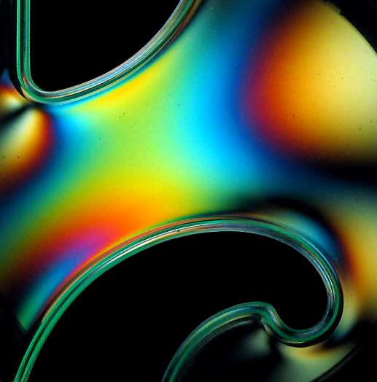
RETARDANCE
Retardance is wavelength dependent, allowing real color indications of strain etc.
Plastic curve-drawing tool photographed between crossed polarizers.
Notes:
Strain can often give materials birefringent properties. This means the polarization state of light exiting the material is no longer the same as that entering. Placed between crossed polarizers the altered light is now transmitted. Since the birefringence is wavelength dependent, different strains show up as different colors.

Slide 26
MEASURING
POLARIZATION
Polarizer
Detector
Analyzer
Notes:
When it comes to measuring polarization, a polarization analyzer is used. This analyzer is just a polarizer as discussed previously, but it is rotated while measuring the light with a detector. The slide shows the arrangement to measure the polarization of a source (i.e. polarizer represents the polarization in the source). We know that two polarizers are reversible however, so to measure the polarization sensitivity of an instrument the polarizer and analyzer roles are reversed.

Slide 27
PARTIAL
POLARIZATION
DEGREE OF POLARIZATION
Notes:
On a polar plot light that is 100% polarized would change from a maximum value to zero (crossed polarizer condition) and look like a double lobe. Completely unpolarized light would have the same signal at all angles and hence be circular. Partially polarized light would be intermediate and appear elliptical or peanut shaped depending on the plot scale.

Slide 28
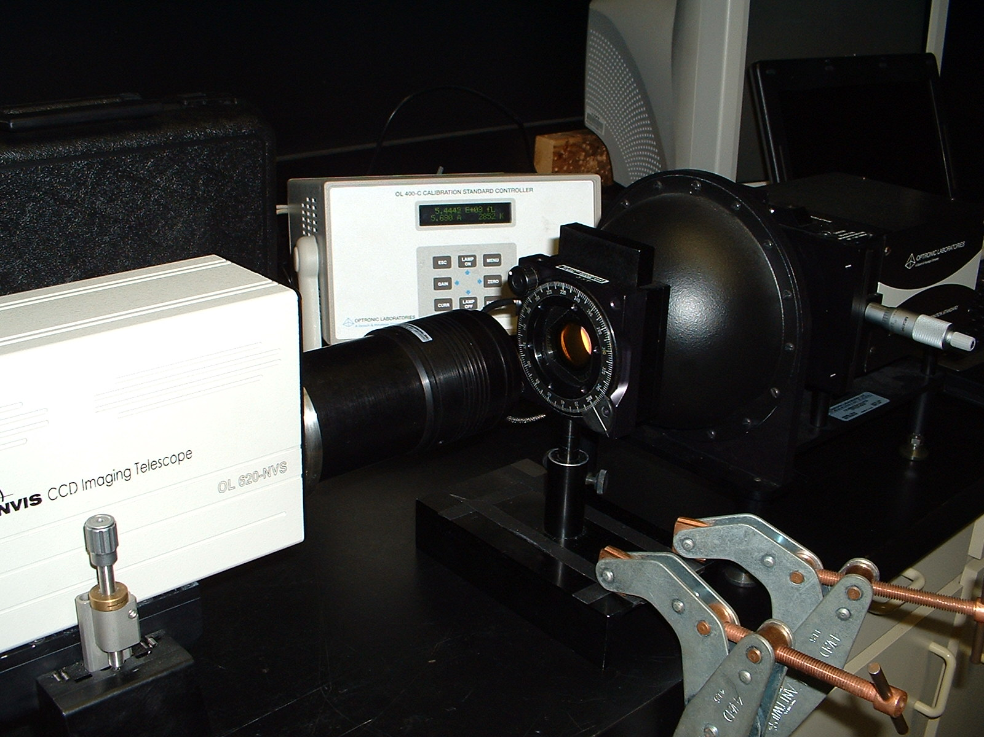
MEASURING
POLARIZATION
Notes:
This is a practical setup for measuring polarization sensitivity of a detector system. The integrating sphere guarantees completely unpolarized light enters the polarization analyzer. The analyzer output should therefore be linearly polarized but of equal intensity at all angles. Measurements of the signal at the detector (radiance or luminance in this case) are made for each angle of the analyzer.

Slide 29
MEASURING
POLARIZATION
550 nm
OL 620-NVS Telescope
Notes:
Here is a typical measurement of a production telescope coupled to an OL 770-NVS system at 550 nm. For comparison, the ±0.5% limits of MIL-STD-3009 are shown in blue and purple. Also, the data is fitted to Malus’ law so the shape can be clearly seen. On this scale of 99% to 101% the curve is slightly elliptical, revealing a low level of polarization sensitivity.

Slide 30
MEASURING
POLARIZATION
900 nm
OL 620-NVS Telescope
Notes:
At 900 nm the curve is almost perfectly circular, indicating negligable polarization sensitivity.

Slide 31
MEASURING
POLARIZATION
OL 620-NVS Telescope
Notes:
In fact polarization sensitivity is usually wavelength dependent, with longer wavelengths being less sensitive. Here we have removed the measured data and shown only the fit for each measurement, revealing the progression with wavelength. It should be noted that the scale has changed for emphasis and that all curves are within ±0.1%.
This slight polarization sensitivity is primarily due to residual strain in the lenses after grinding.

Slide 32
MEASURING
POLARIZATION
550 nm
Commercial Camera Lens
Notes:
Commercial camera lenses are made to a very high quality but are more than 3 times worse in polarization sensitivity than the OLI lenses.

Slide 33
MEASURING
POLARIZATION
550 nm
Alternate Telescope Design (NOT an Optronic Labs product)
Notes:
Some telescope designs and much worse. This example is more than 30 times worse than the OL 620 and fails the MIL-STD-3009 requirements.

Slide 34
MEASURING
POLARIZATION
550 nm
Monochromator System without Depolarizer
Notes:
Probably the worst of all is a telescope directly coupled to monochromator. This polarization sensitivity is due to the monochromator and not the telescope. This shows that the maximum to minimum sensitivities is a factor of 3. In this case, a depolarizer is essential to remove the polarization error and obtain reliable results.
This result also illustrates that although the polarization error is specified as a photometer requirement, it should apply to spectroradiometers too. As a general principle, without correction spectroradiometers are much more likely to exhibit high polarization errors than photometers. The lack of a polarization specification within the spectroradiometer section must there be viewed as an oversight. With appropriate depolarization, there is no reason why a spectroradiometer should not pass this test and hence give reliable results.

Slide 35
A.4.6 PHOTOMETER POLARIZATION ERROR
• The polarization error shall be no greater than 1%.
A.4.6.1 PHOTOMETER POLARIZATION ERROR VERIFICATION
• The polarization error shall be checked by placing a linear polarizer in the optical path between the standard lamp and the photometer and then measuring the luminance. The polarizer shall be rotated 45° and another measurement shall be made. The polarizer shall be rotated another 45° and another measurement shall be made. The photometer shall be considered as having passed the polarization error test if the difference between the three measurements is lower than or equal to the percent error specified in A.4.6. Throughout the test the alignment of the standard lamp shall not be changed. The transmission of the linear polarizer shall be greater than or equal to 20%, and the transmission of two pieces of the polarizer material, when oriented so that the direction of polarization of the two pieces are at right angles, shall be less than or equal to 0.1%.
MIL-STD-3009 (MIL-L-85762A)
Notes:
Returning to the MIL specifications, the method described relies on just 3 measurements at 45° intervals. How does this fit with the complete rotation tests? Also, “difference between the three measurements” refers to a difference but “percent error” implies a ratio without specifying if it is a ratio of the difference to the maximum, average or other value. This ambiguity can lead to several possible interpretations of the specification.

Slide 36
MIL-STD-3009 (MIL-L-85762A)
Notes:
Degree of polarization is (max-min)/max when applied to the complete rotation measurement. If we assume that the MIL specification of polarization error is attempting to define the same quantity over the 3 measurement angles we can calculate the relationship between the two techniques.
Taking 100% polarization to illustrate the relationship, we can start at any angle. At -45°/0°/+45° we see that the polarization error is 50%; very different to the degree of polarization .

Slide 37
MIL-STD-3009 (MIL-L-85762A)
Notes:
If we measure 0°/+45°/+90° the calculated polarization error is 100%, agreeing with the degree of polarization.

Slide 38
MIL-STD-3009 (MIL-L-85762A)
Notes:
Angles of +45°/+90°/+135° also give 100% polarization error.

Slide 39
MIL-STD-3009 (MIL-L-85762A)
Notes:
If we plot the polarization error indicated by the MIL specification against the central angle we can see the value varies between 50% and 100%. It is only 100% at 6 specific sets of angles and everywhere else the result is different to the degree of polarization.
This indicates that although it is likely the authors of the standard intended some equivalence of polarization error to degree of polarization, the two are not at all equivalent. Moreover, they are only equal at the worst case angles and it is likely that some manufacturers would conduct tests at best case conditions since this makes their instruments look better.

Slide 40
• Although humans do not see polarization of light, its effects are wide ranging.
• Spectroradiometers and telescopes can have large polarization errors unless corrected.
• These polarization errors can lead to incorrect luminance and color values.
• MIL-STD-3009 says how polarization error must be measured.
- But the method is open to interpretation and may give inconsistent results.
THE VIKINGS
Notes:
A bit of history: Polarization was possibly used as an aid to navigation by the Vikings around 1000 years ago. This predates the use of the compass in the western world!

Slide 41
• The system illustrated represents just a few of the accessories from Optronic Laboratories, LLC
• For more information:
Visit our website at OptronicLabs.com
Call 407-422-3171 to Contact an Application Engineer
MORE INFORMATION

